Slide 1







Connecting Dots
Your extra is someone’s need.

Slide 2
Group No : 26
A29 Kumawat Mukesh 202100319010027
B71 Prajapati Laxmi 202100319010164
C34 Lil Drashti 202100319010222
PROJECT GUIDE:-PROF. DEEP FACAIT,BCA.

Slide 3
Index
01
Company Details
05
Reports
02
Introduction
06
User Panel Screenshots
03
Project Profile
07
Conclusion
04
Admin Panel Screenshots
08
Bibliography

Slide 4
01
Company Details

Slide 5
Name : Aarnik Technology
Contact No : 9586248516
Website : aarniktechnology.com
Email ID : info@aarniktechnology.com
Address : K/8, Shree Krishna Centre Above Crossword Library, Mithakali Six Road, Navrangpura , Ahmedabad- 380009.

Slide 6
02
Introduction

Slide 7
Introduction
“Connecting Dots” will provide a facilities that donors can directly connect to the NGOs and donor can donate required donation to them.
With the help of this website user can search for NGO area wise.
User can book various events in NGO and NGO will upload related videos on website.

Slide 8
03
Project Profile

Slide 9











System Requirement
Software Used :
Server :-
Front End :-
Back End :-
Open Source Library :-
Scripting Language :-
Visual Studio
draw.io

Slide 10

Existing System
At that time, We Don’t have any system. We have worked manually.
Users needs to search NGO from google.
Users has to visit NGO manually to get all information about the NGO.

Slide 11




Proposed System
Users can easily find various NGOs by location and get all the information about NGOs from the website.
Volunteer will collect the donation item from user and deliver to the NGO.
NGO can share their requirement on website , User can view and donate according to the NGOs requirements.
System will also provide payment gateway to pay donation online.

Slide 12
04
Admin Panel Screenshots

Slide 13
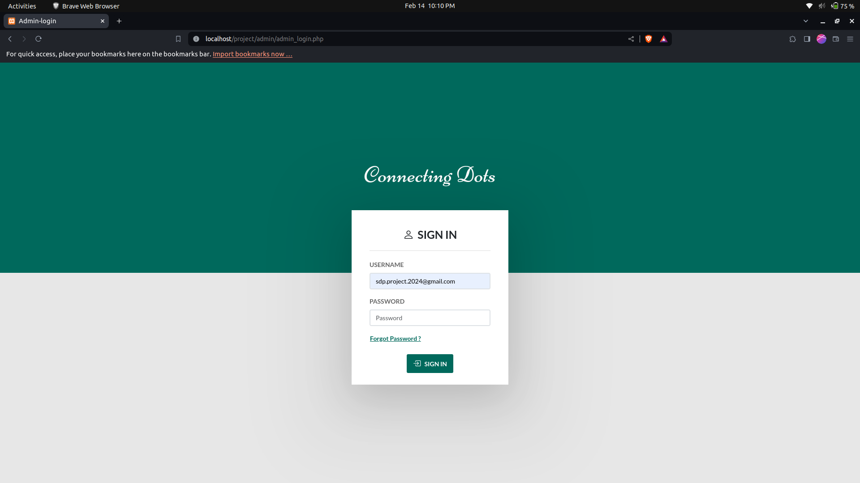
Login Page:

Slide 14

Login with wrong Details:

Slide 15
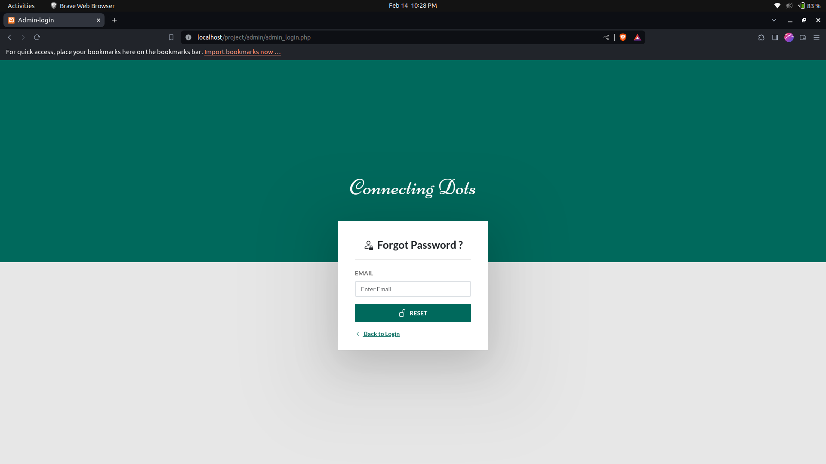
Forgot Password:

Slide 16
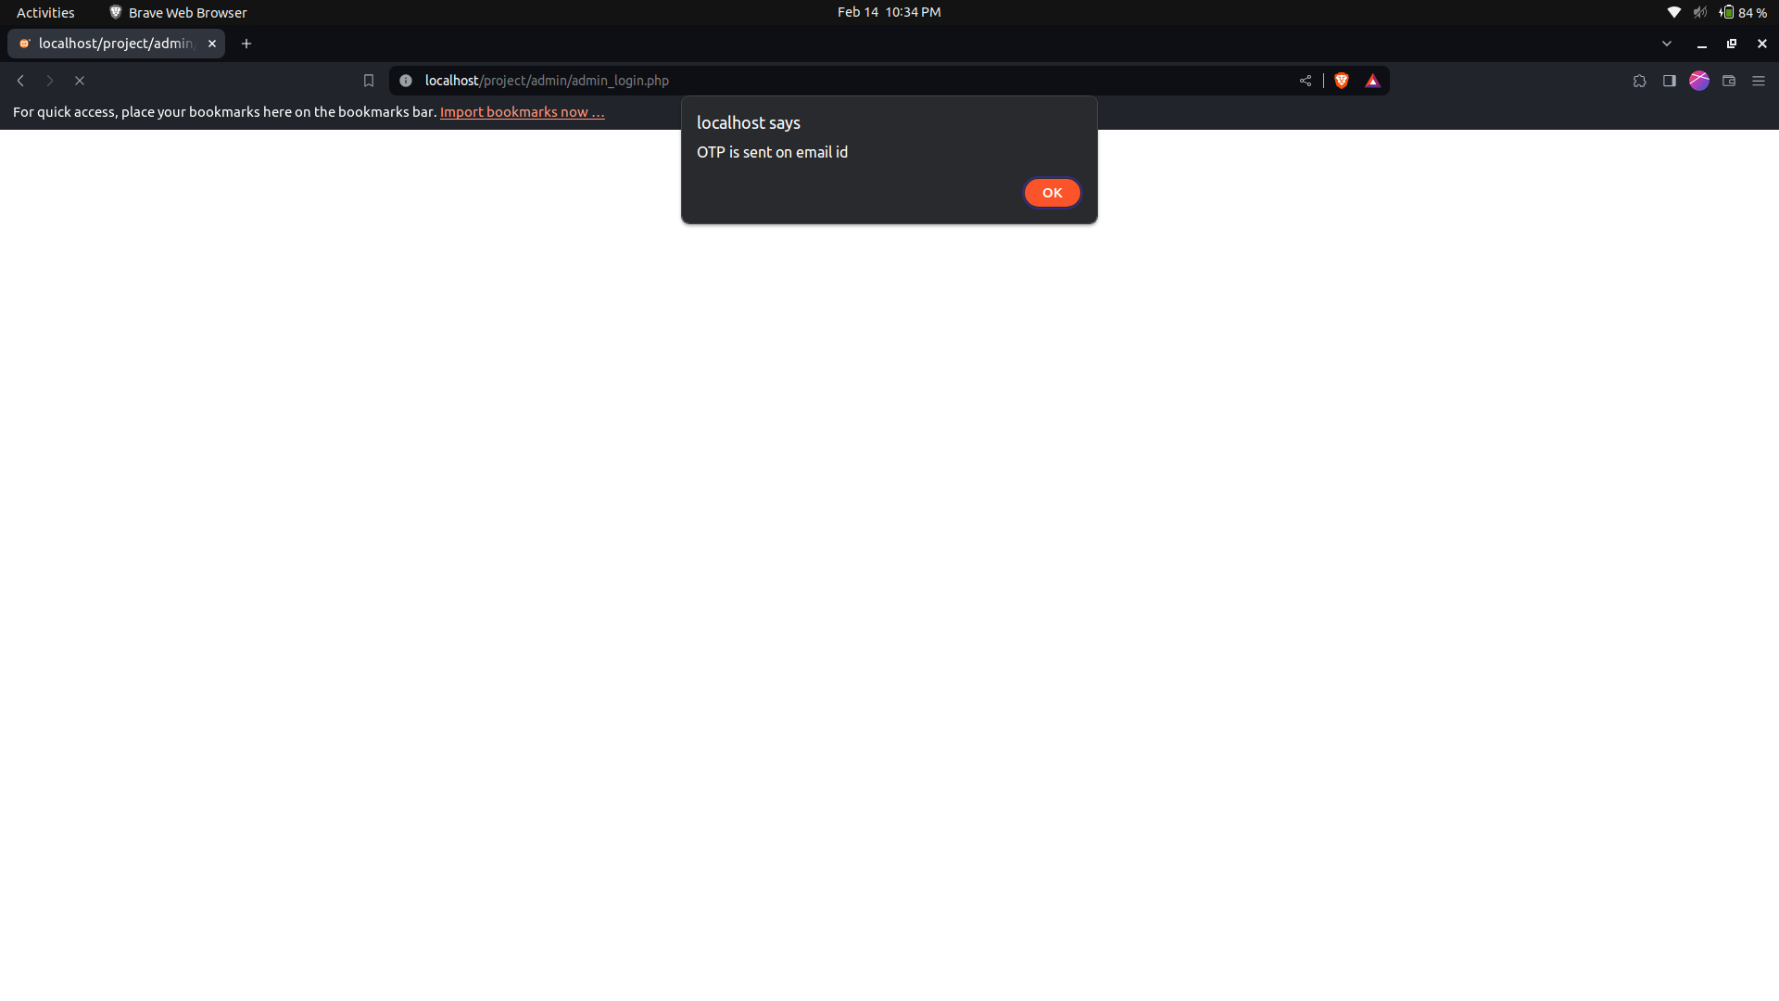
OTP sent to the Email:

Slide 17
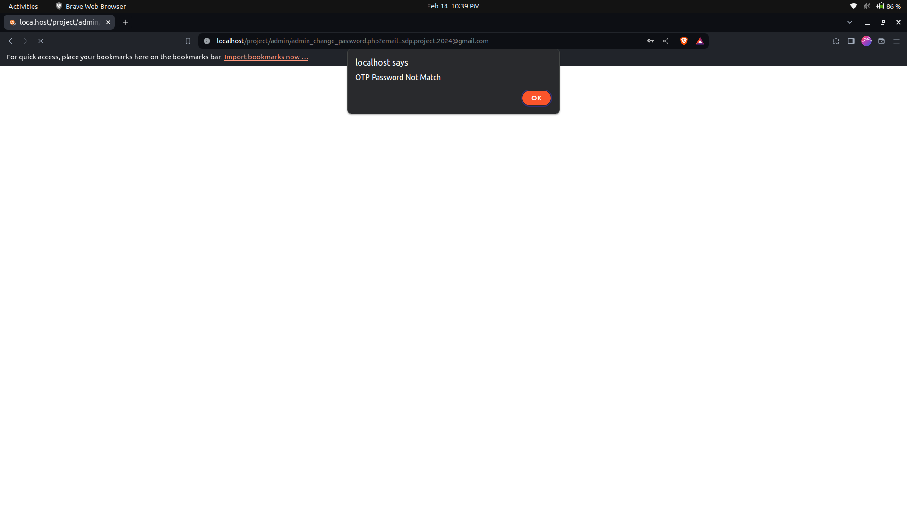
Incorrect OTP:

Slide 18

OTP and New Password:

Slide 19
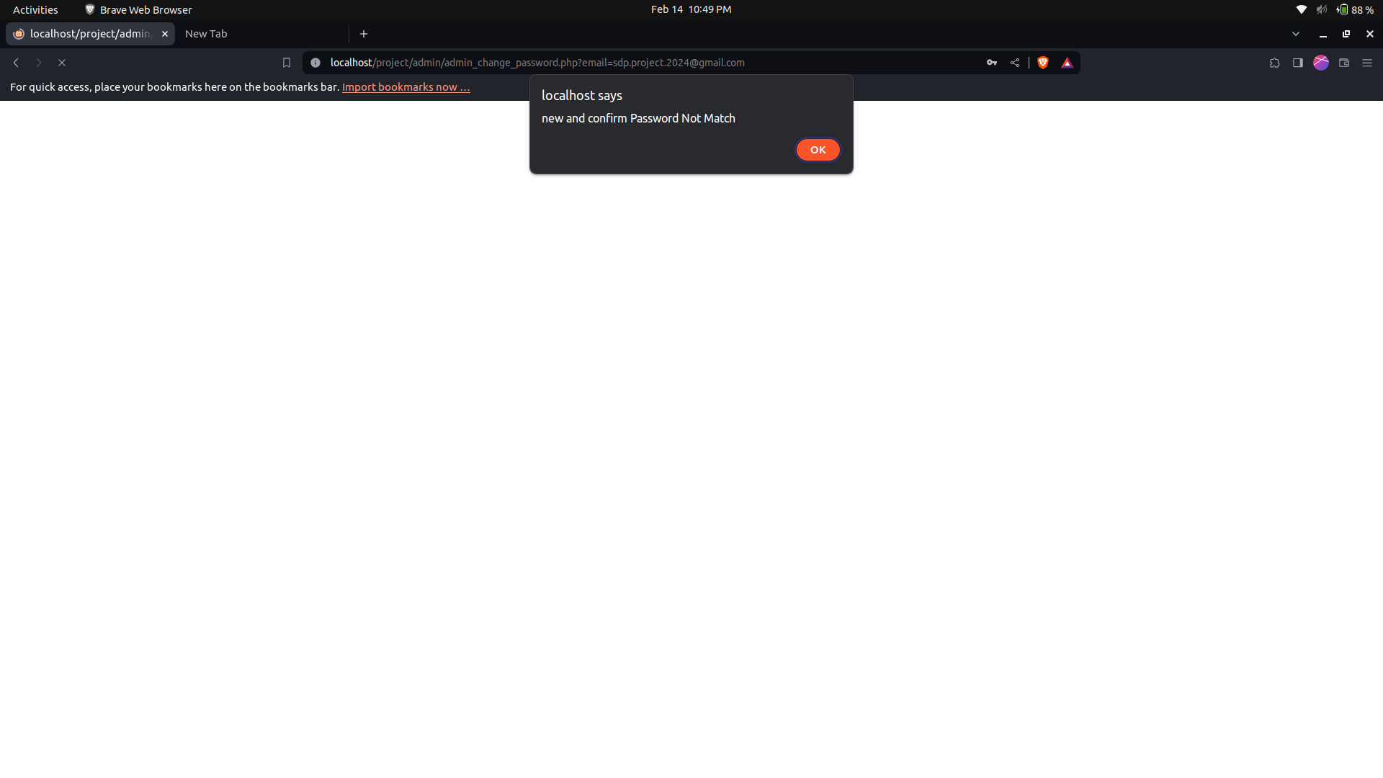
New and Confirm Password:

Slide 20

Change Password:

Slide 21
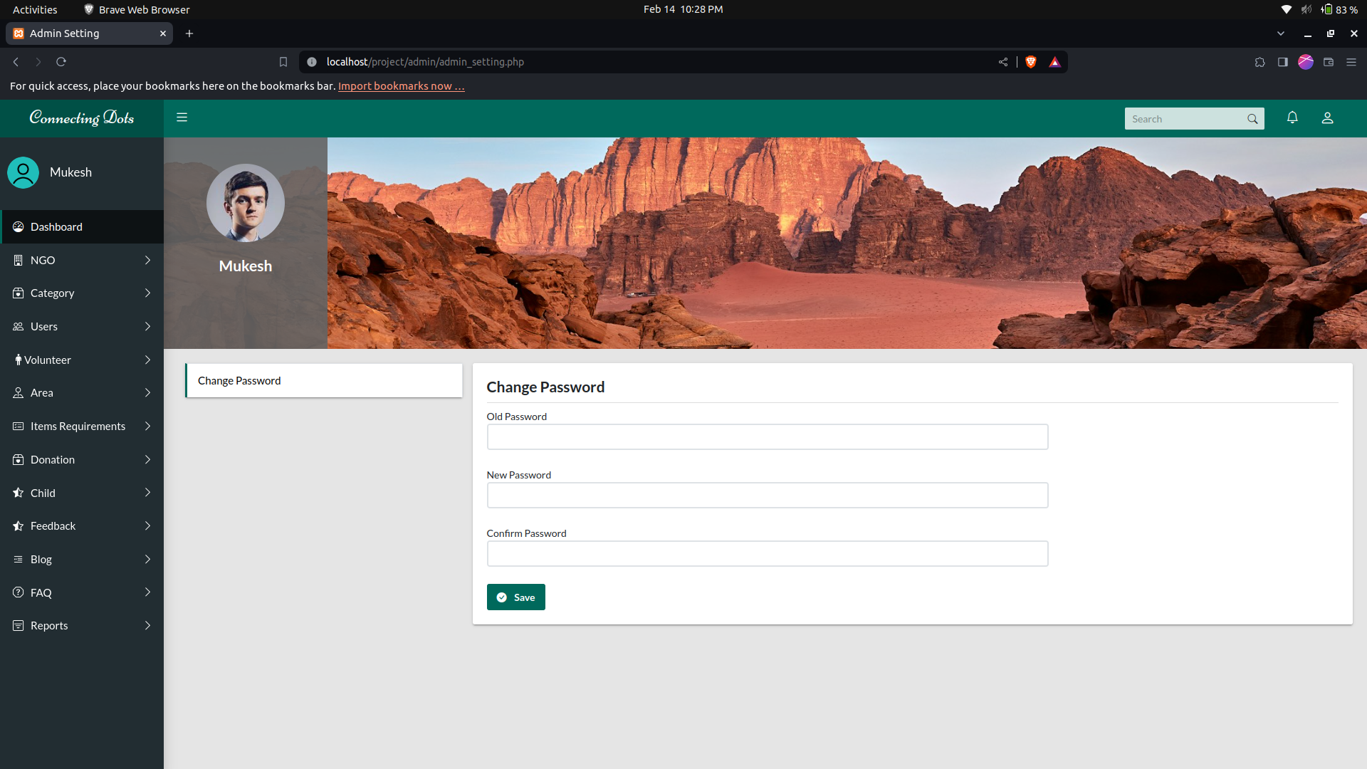
Admin Change Password:

Slide 22
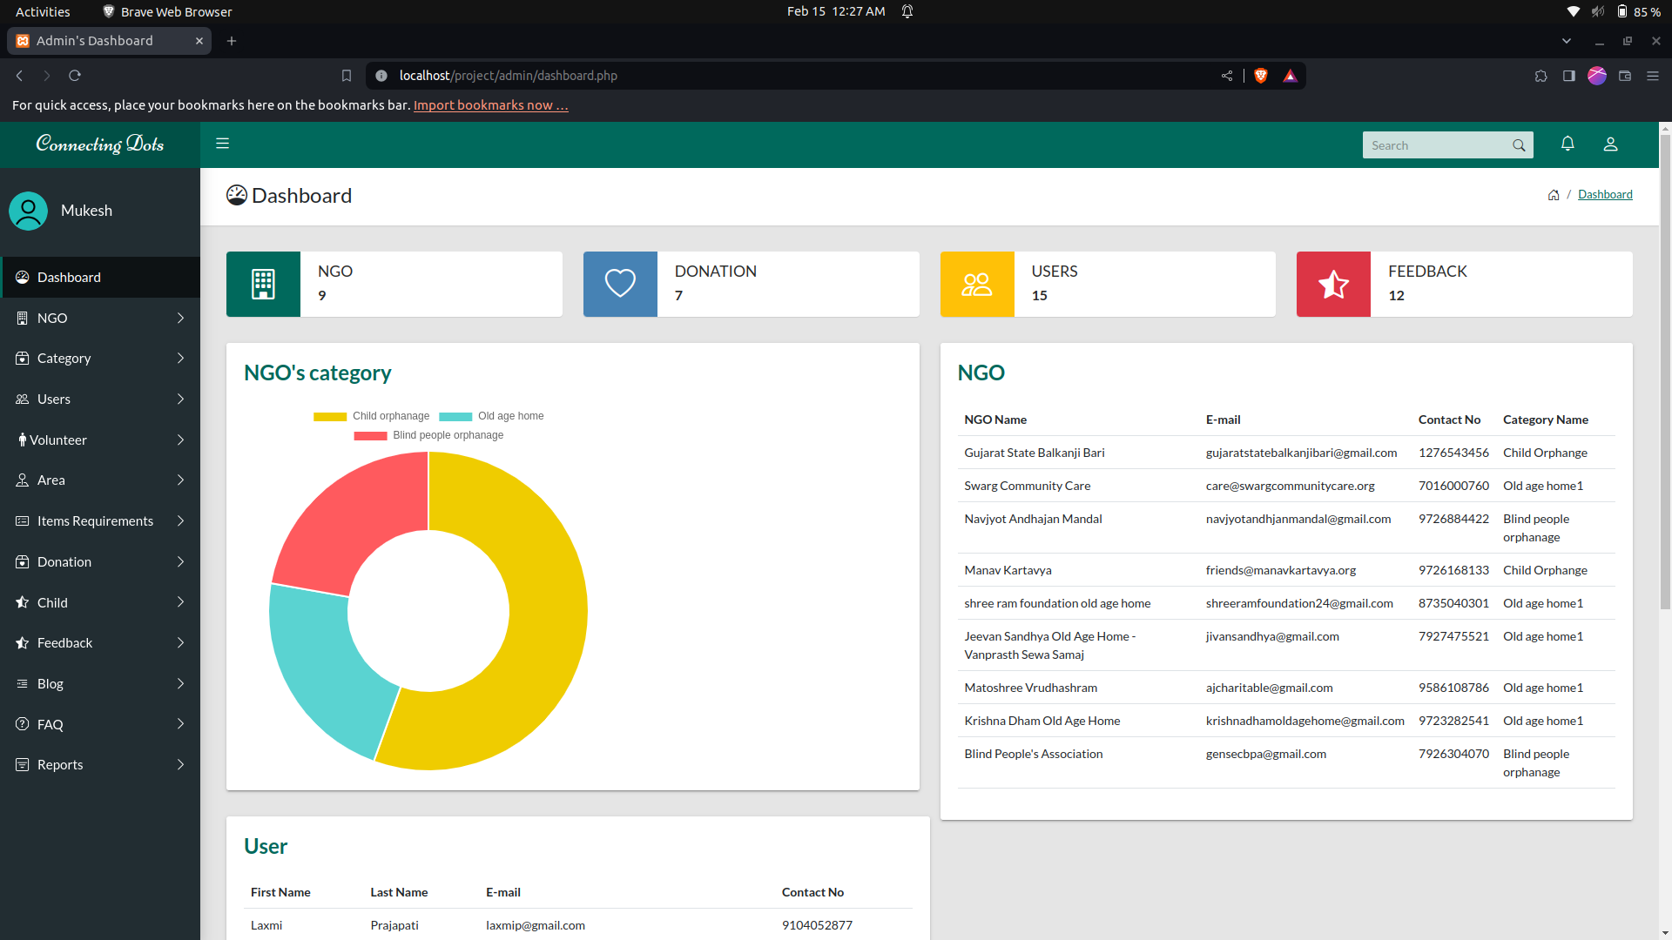
Admin Dashboard:

Slide 23
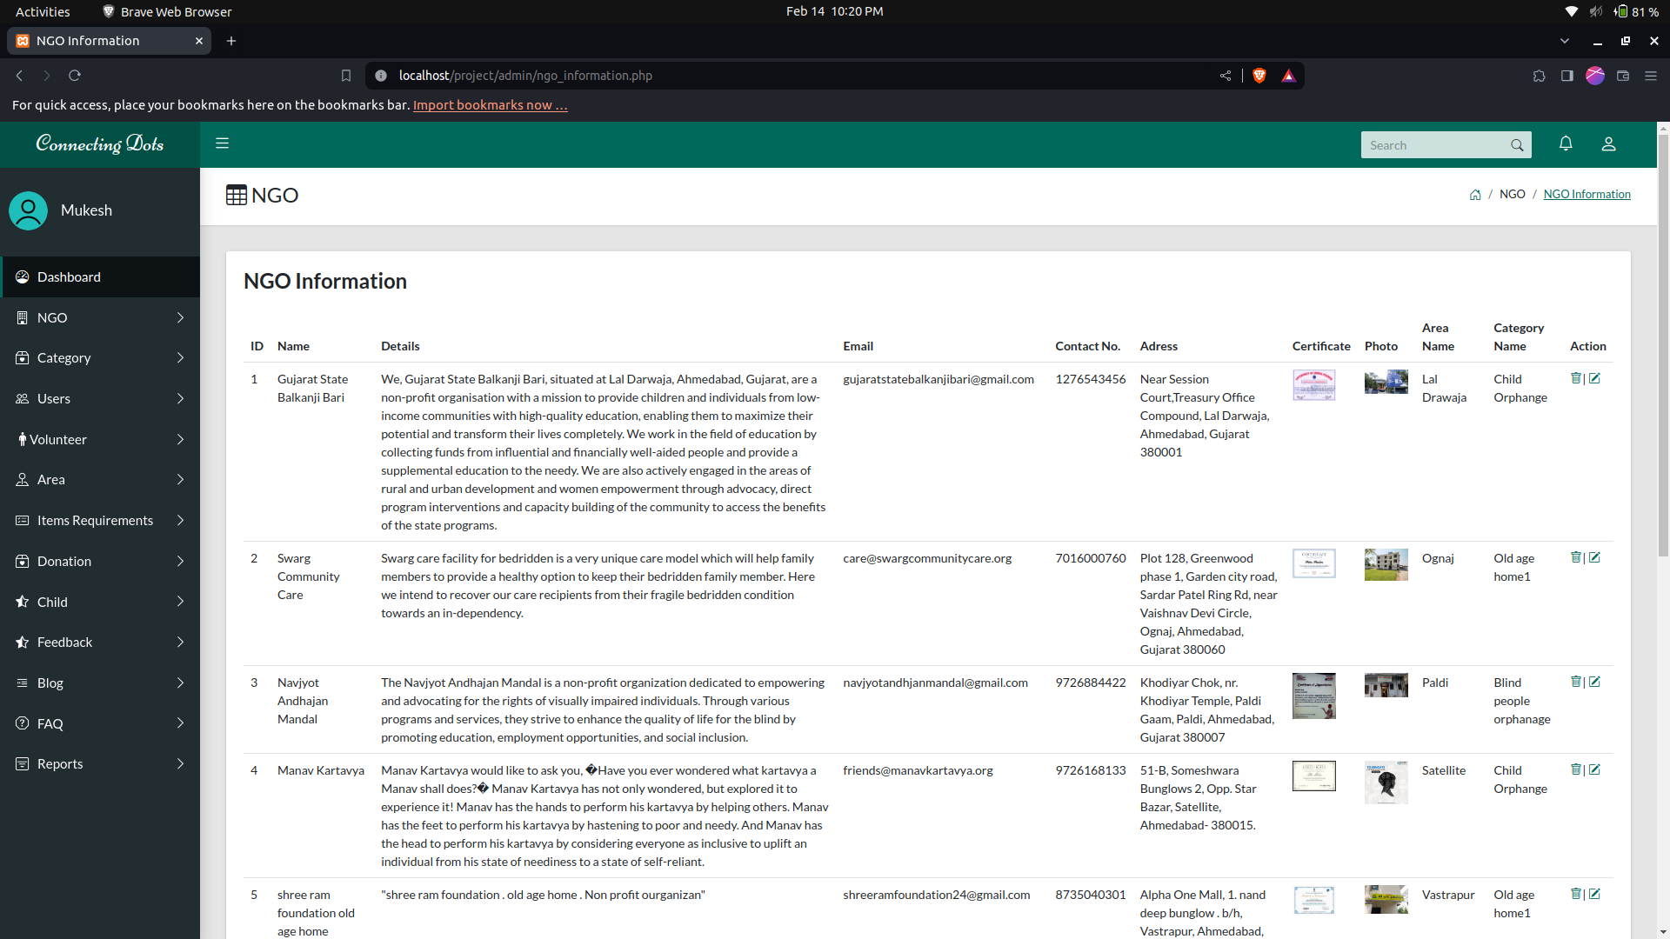
NGO Information:

Slide 24
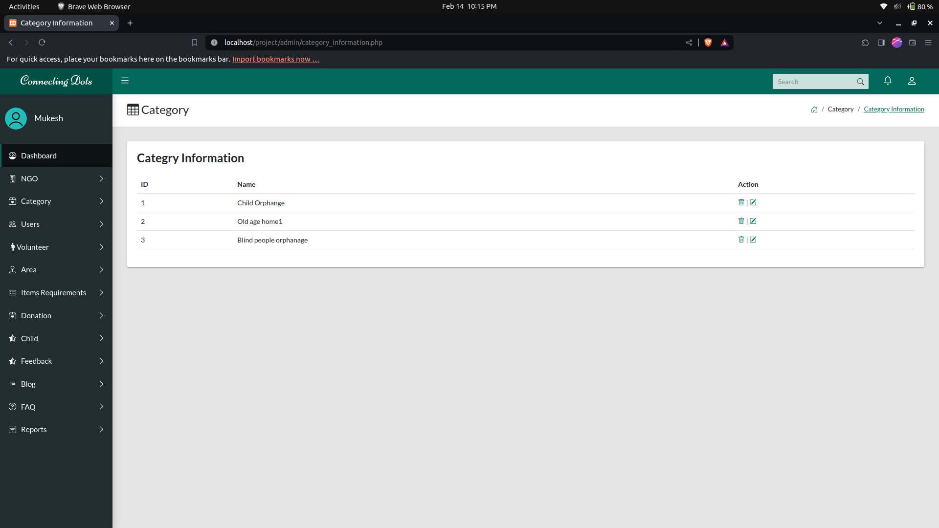
Category Information :

Slide 25
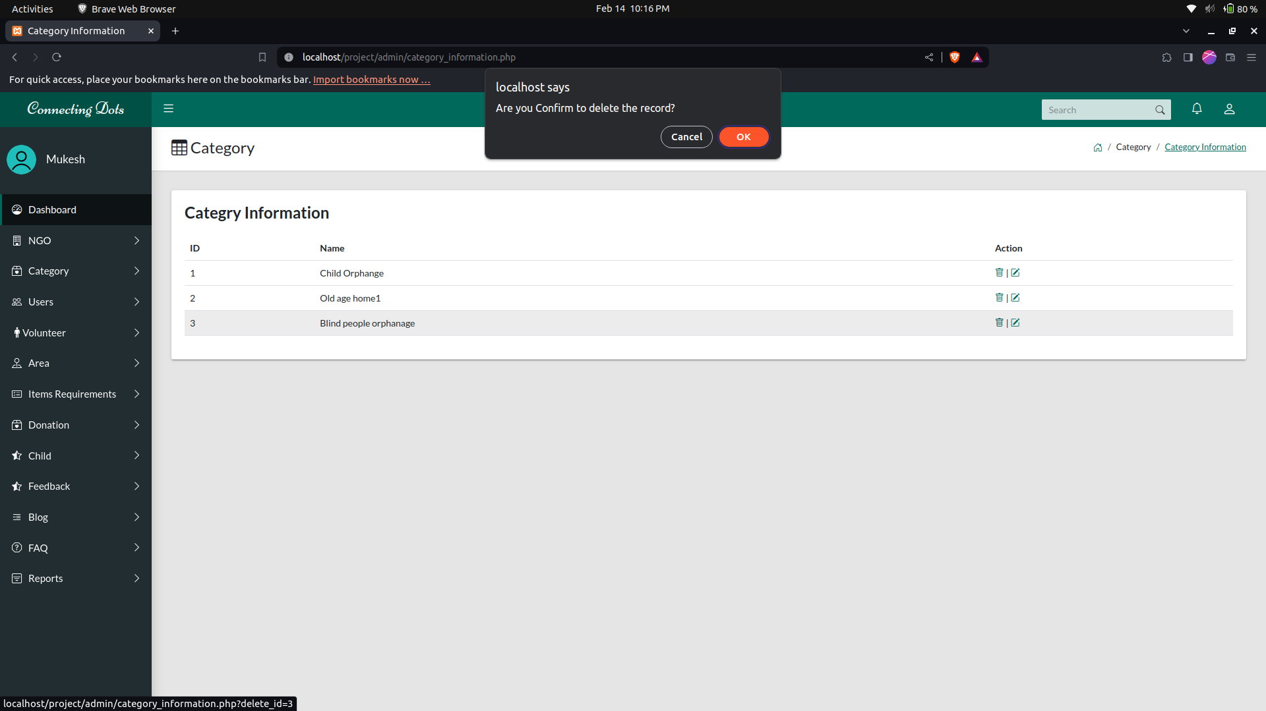
Delete Category:

Slide 26
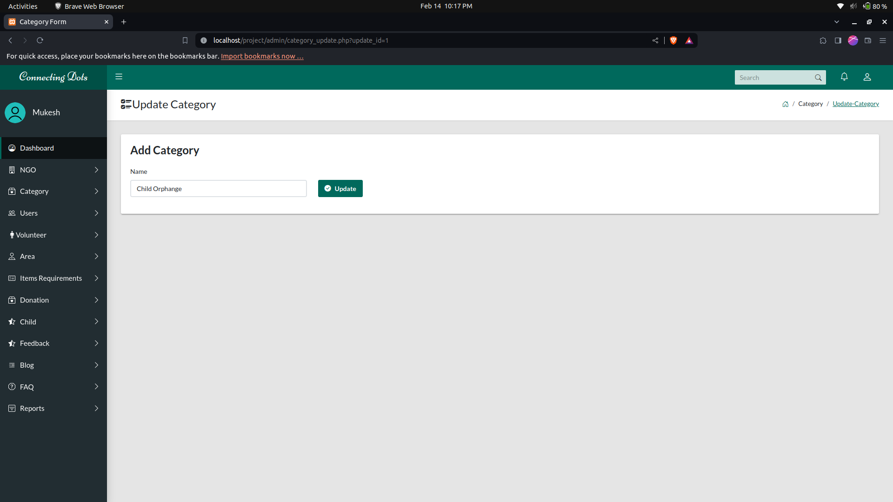
Update Category:

Slide 27
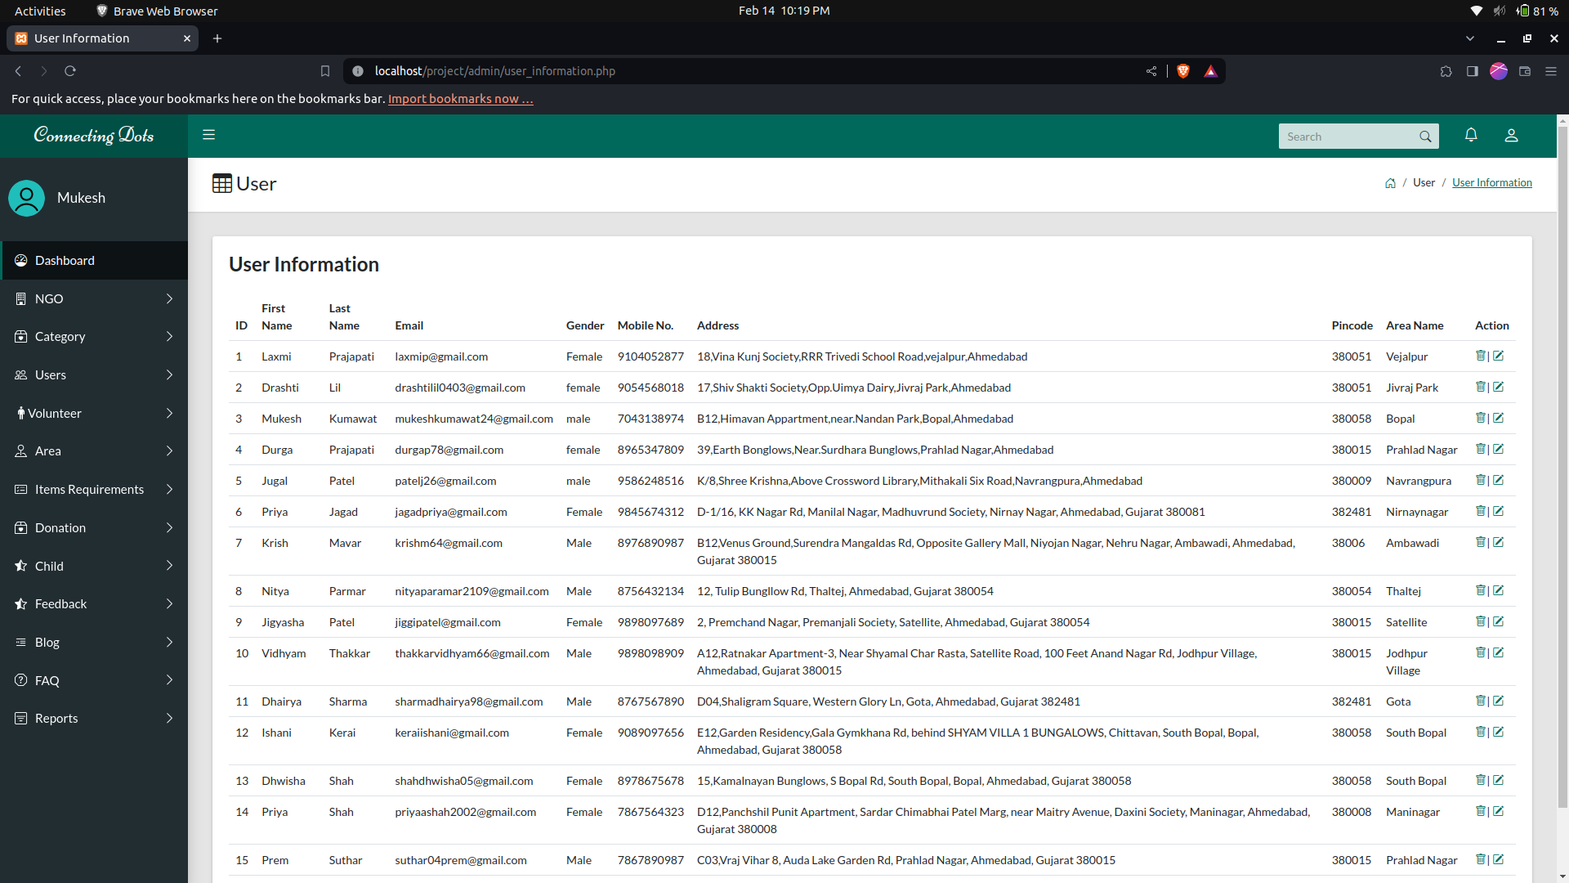
User Information :

Slide 28
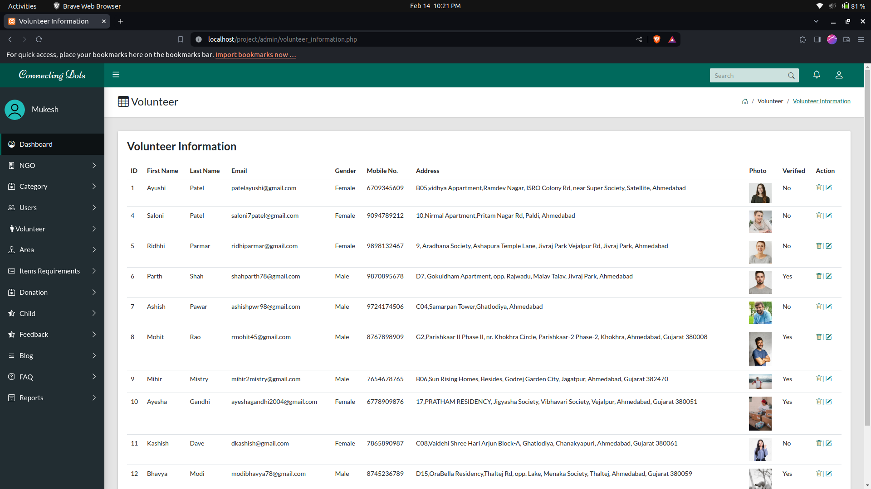
Volunteer Information :

Slide 29
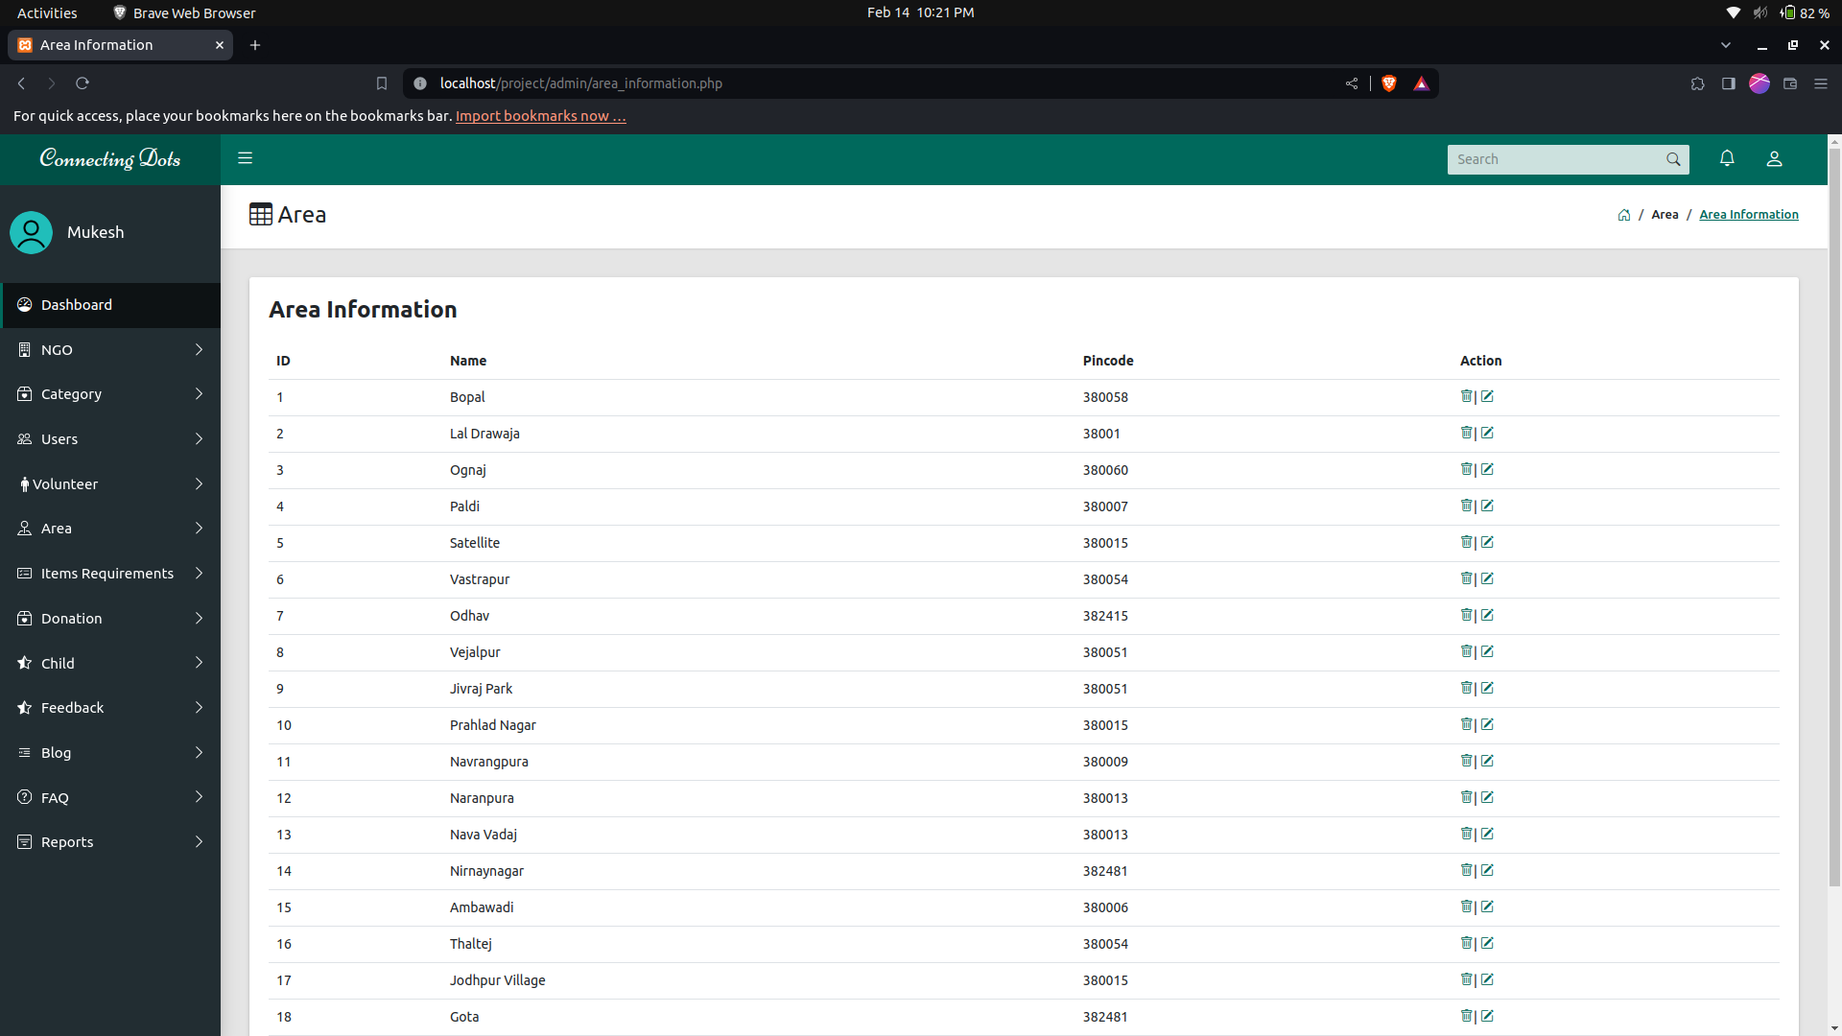
Area Information :

Slide 30
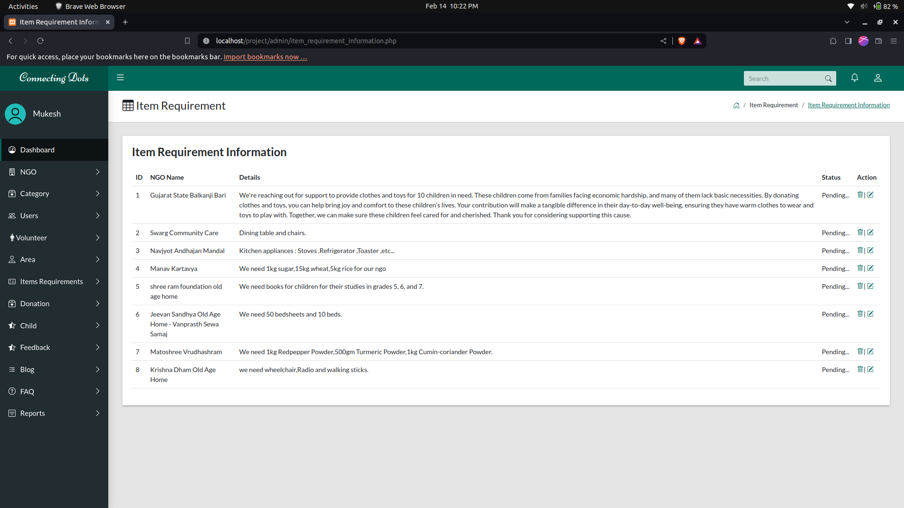
Requirement Information :

Slide 31
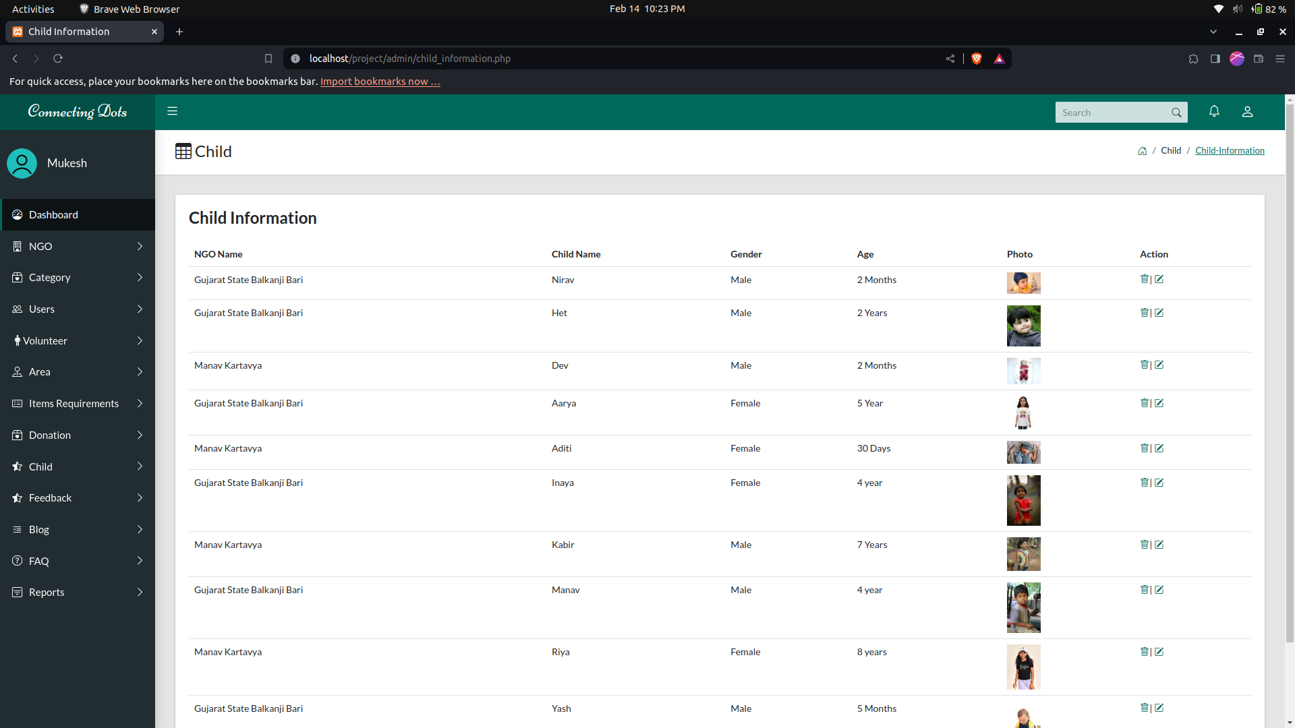
Child Information :

Slide 32
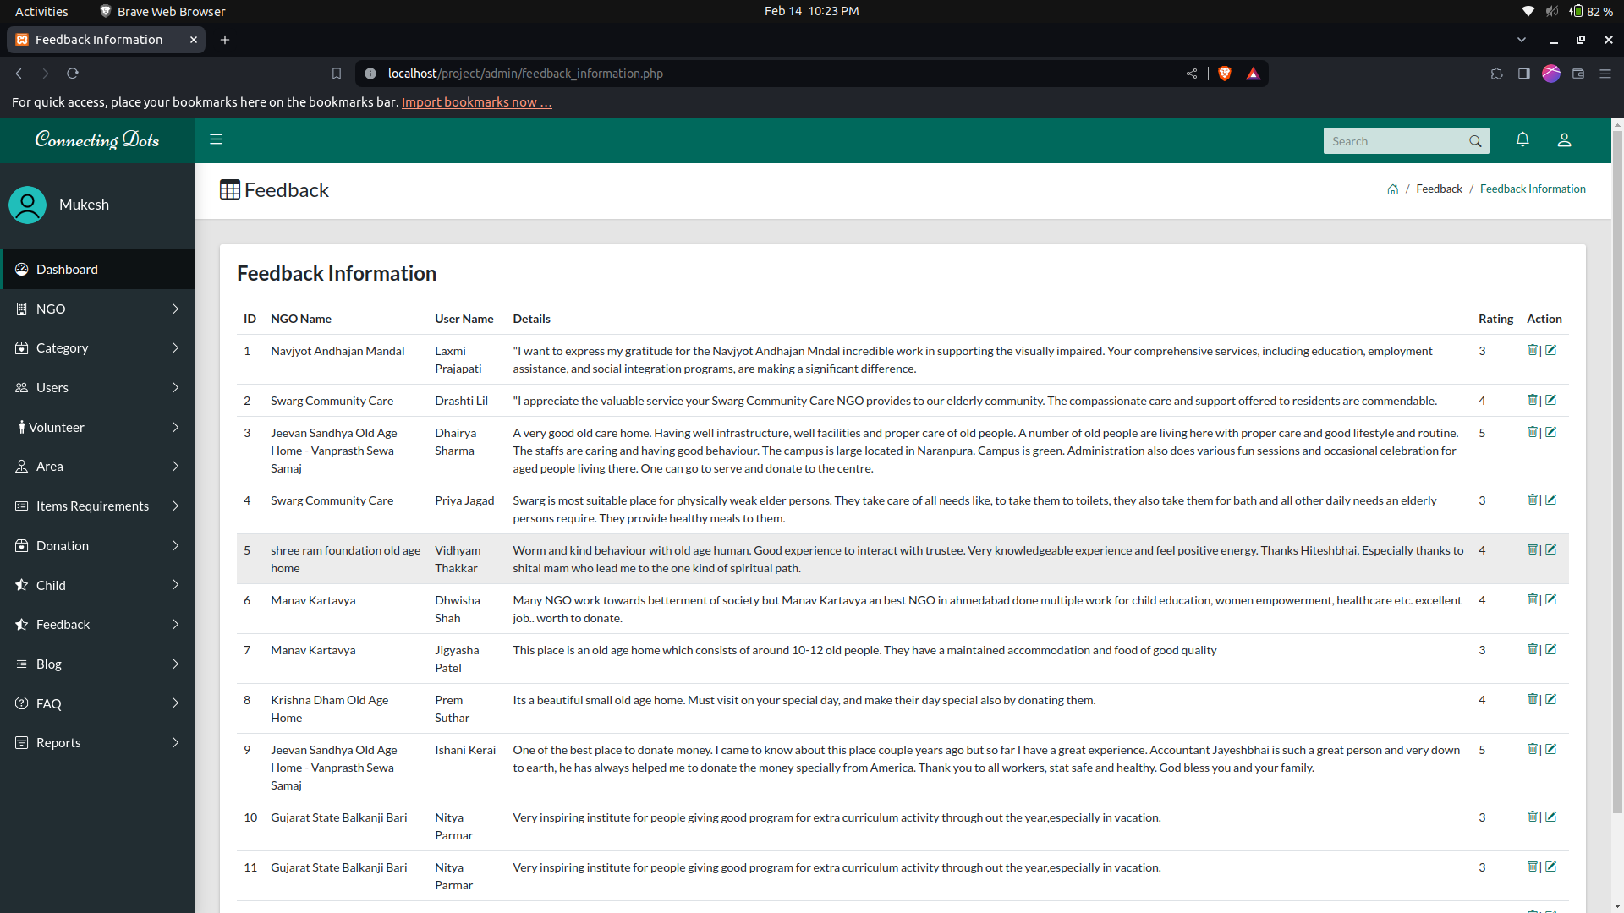
Feedback Information :

Slide 33
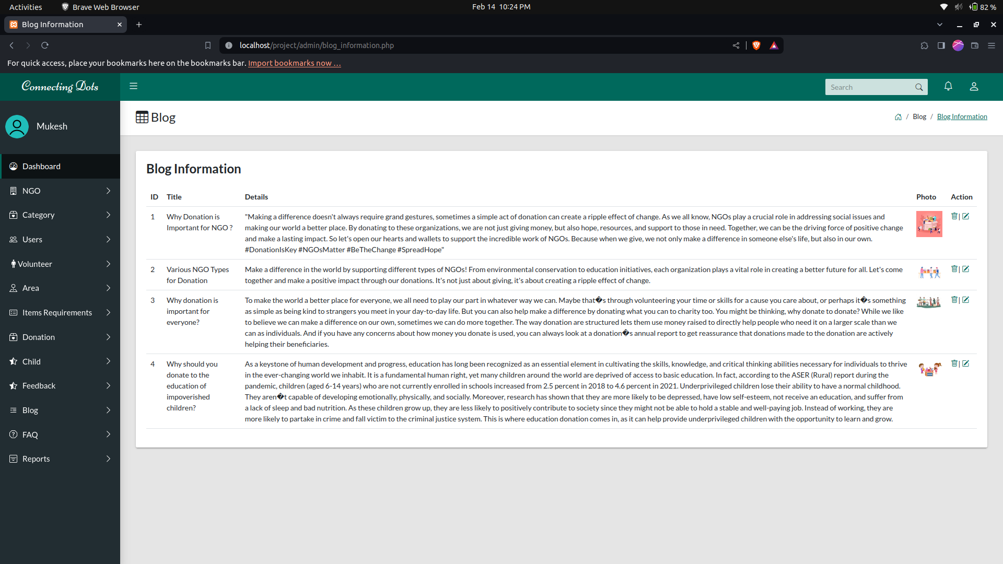
Blog Information :

Slide 34
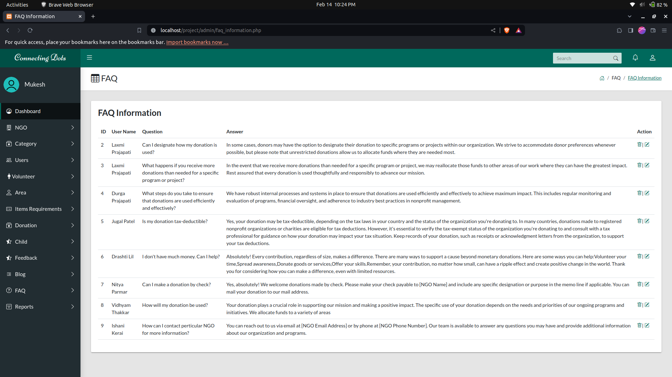
FAQ Information :

Slide 35
05
Reports

Slide 36
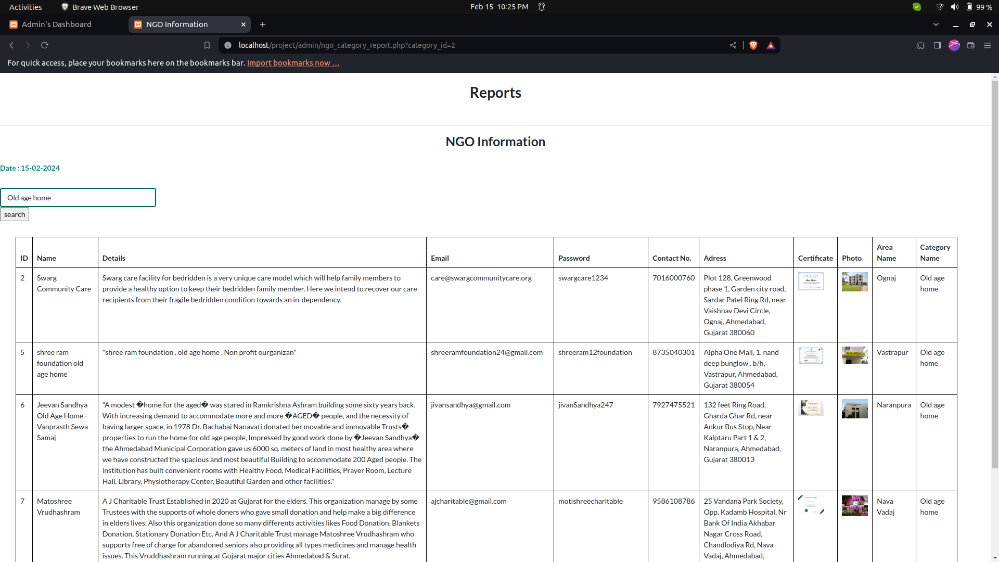

Slide 37
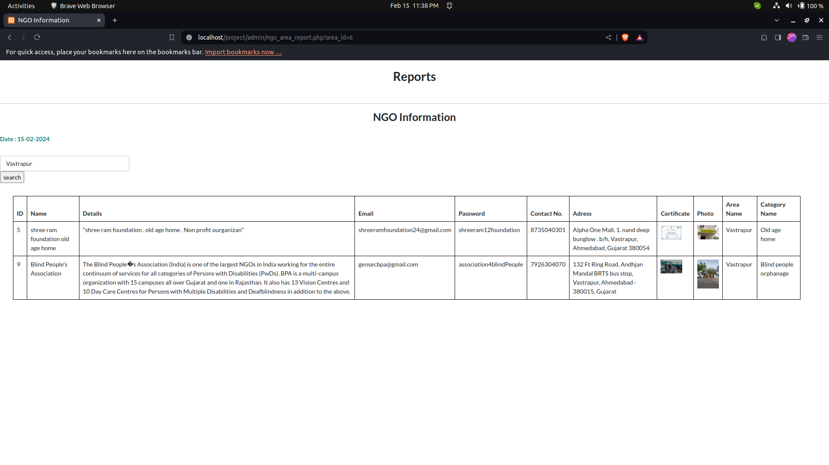

Slide 38
06
User Panel Screenshots

Slide 39
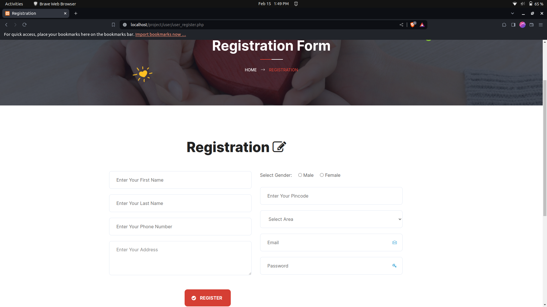
User Registration:

Slide 40
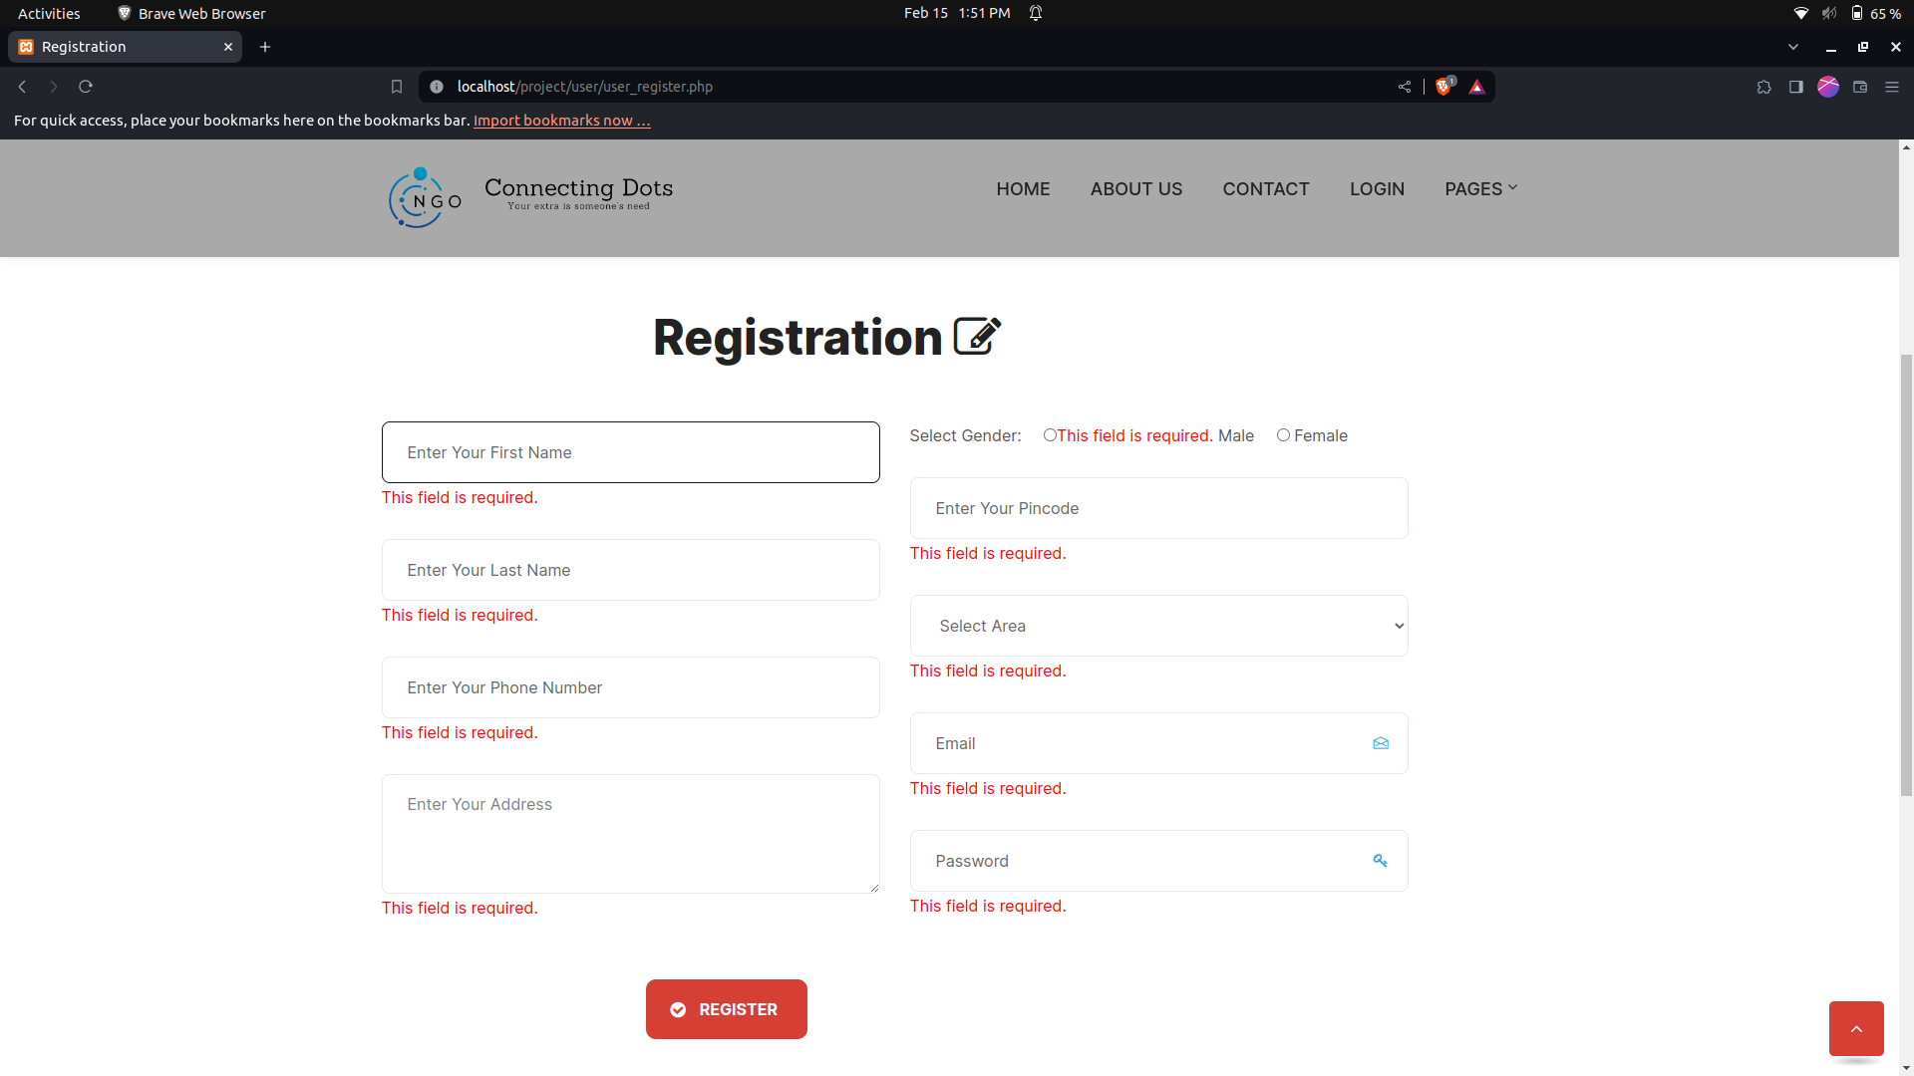

Slide 41
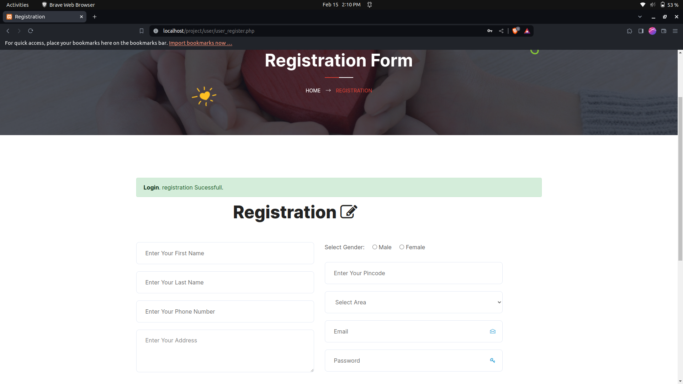
User Registration Successful:

Slide 42
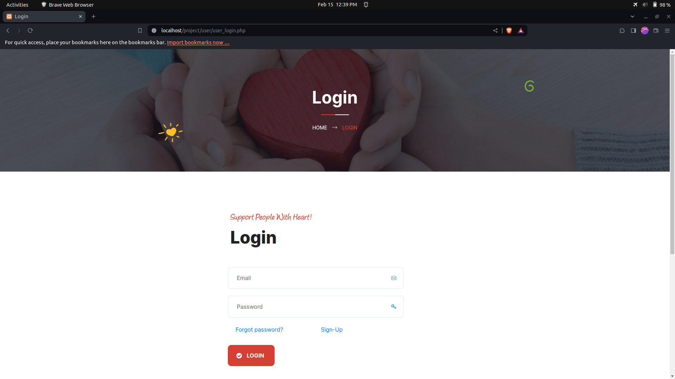
User Login:

Slide 43
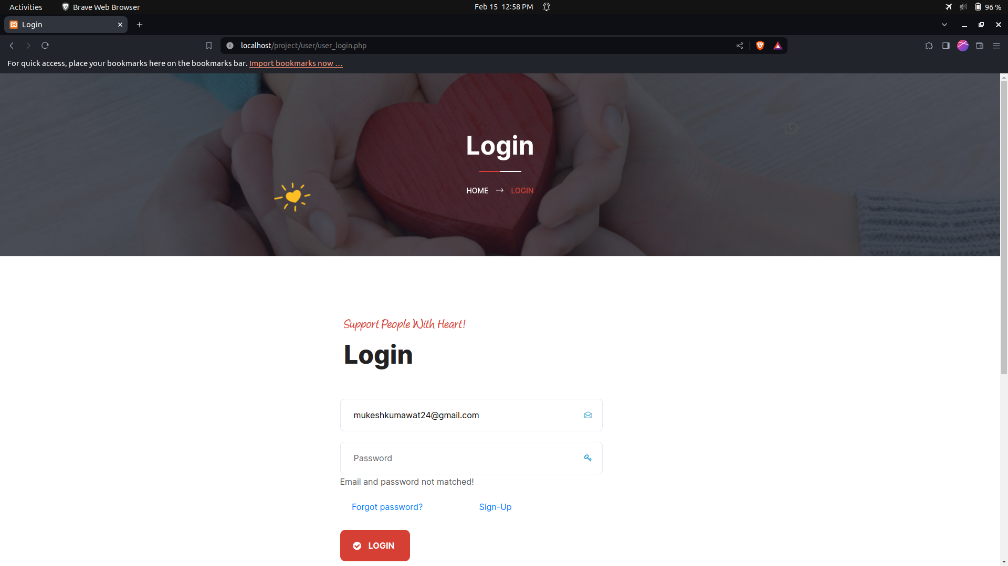
User Login with Wrong Details:

Slide 44
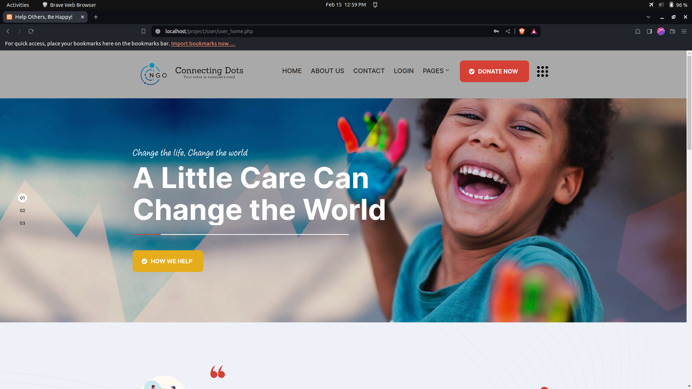
User Home Page:

Slide 45
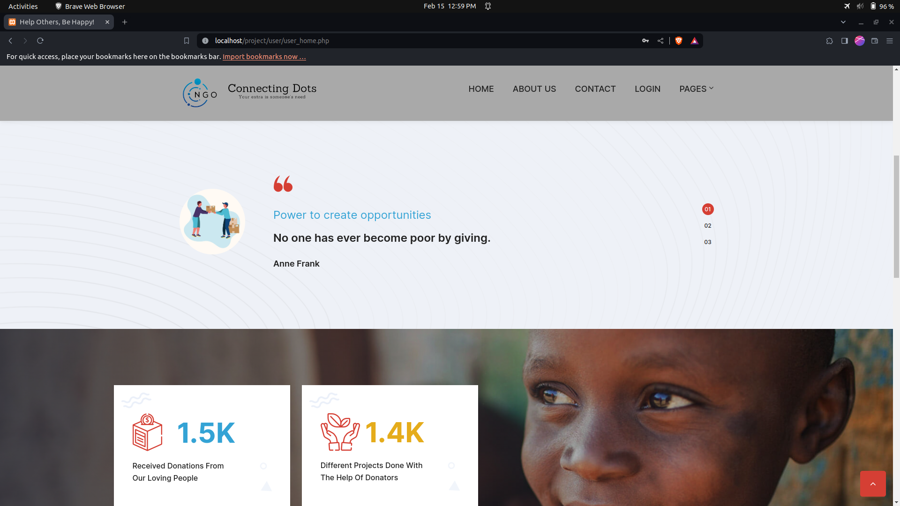
User Home Page:

Slide 46
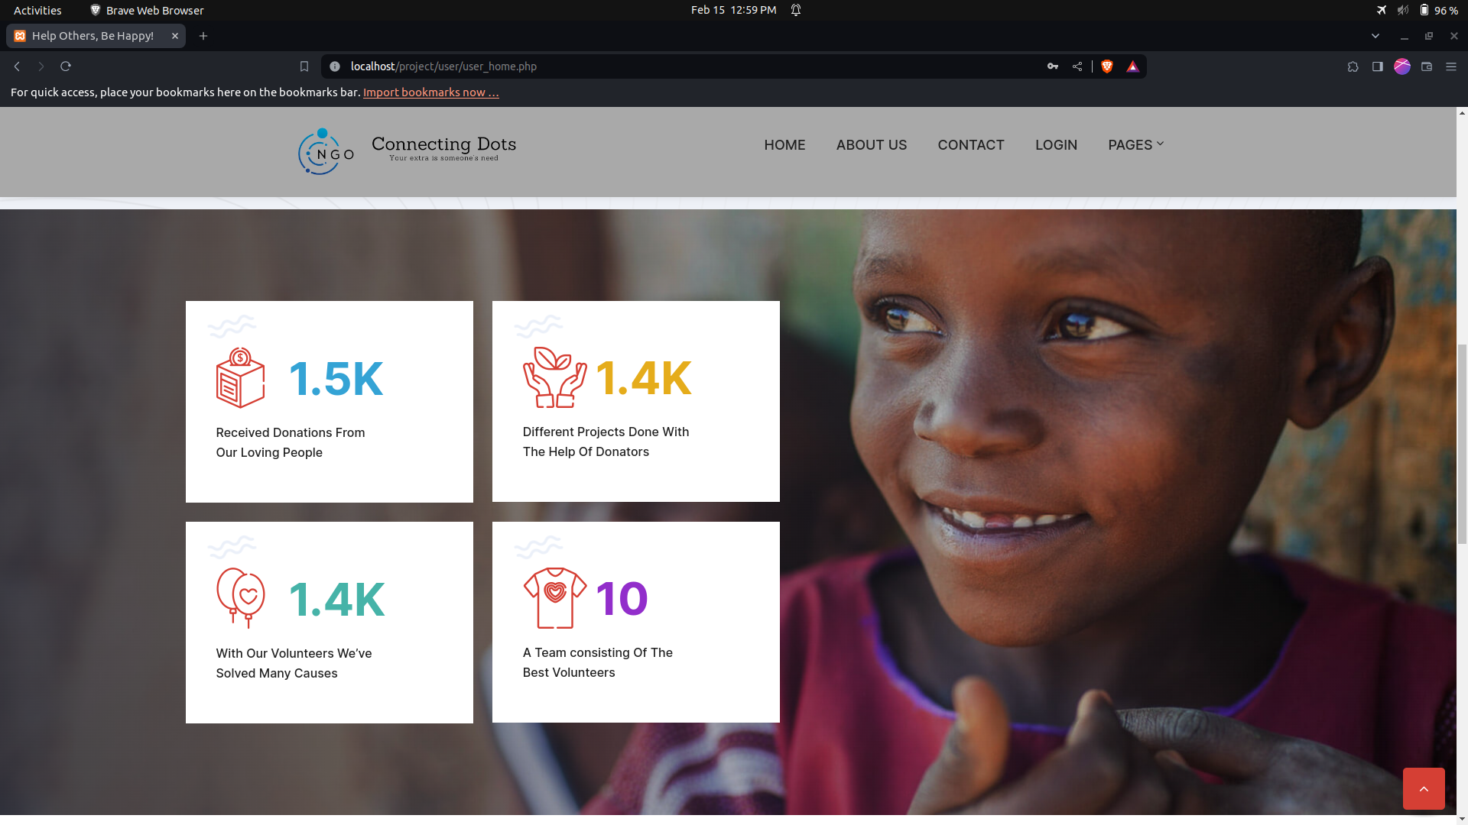
User Home Page:

Slide 47
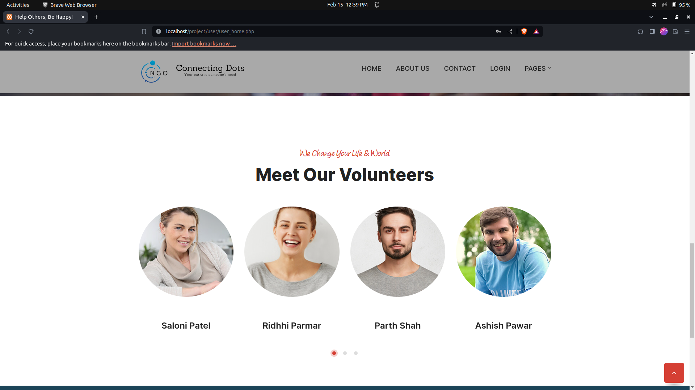
User Home Page:

Slide 48
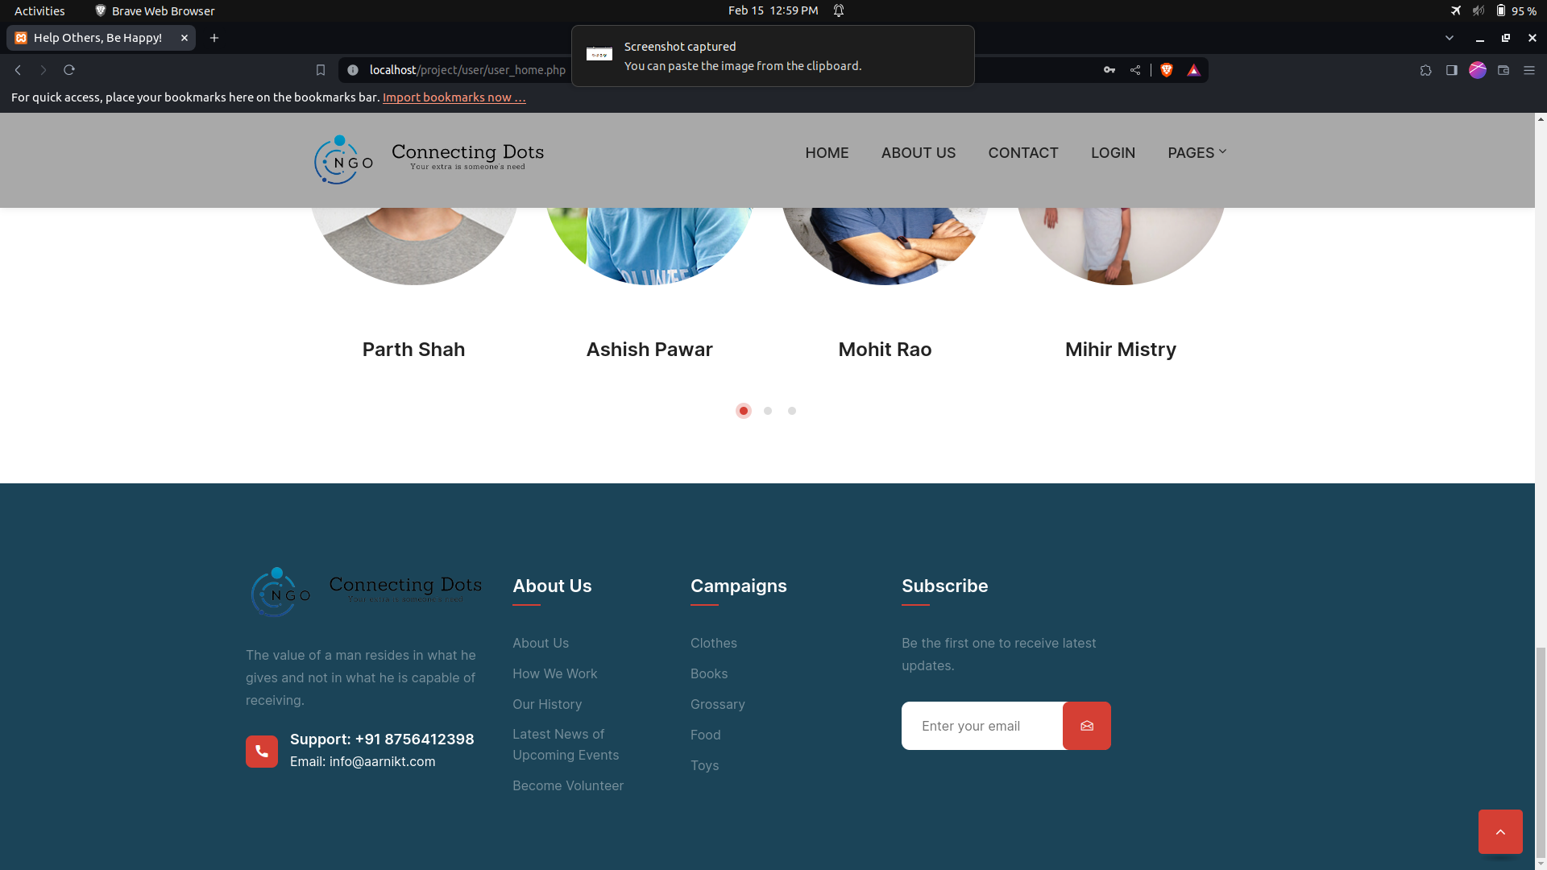
User Home Page:

Slide 49
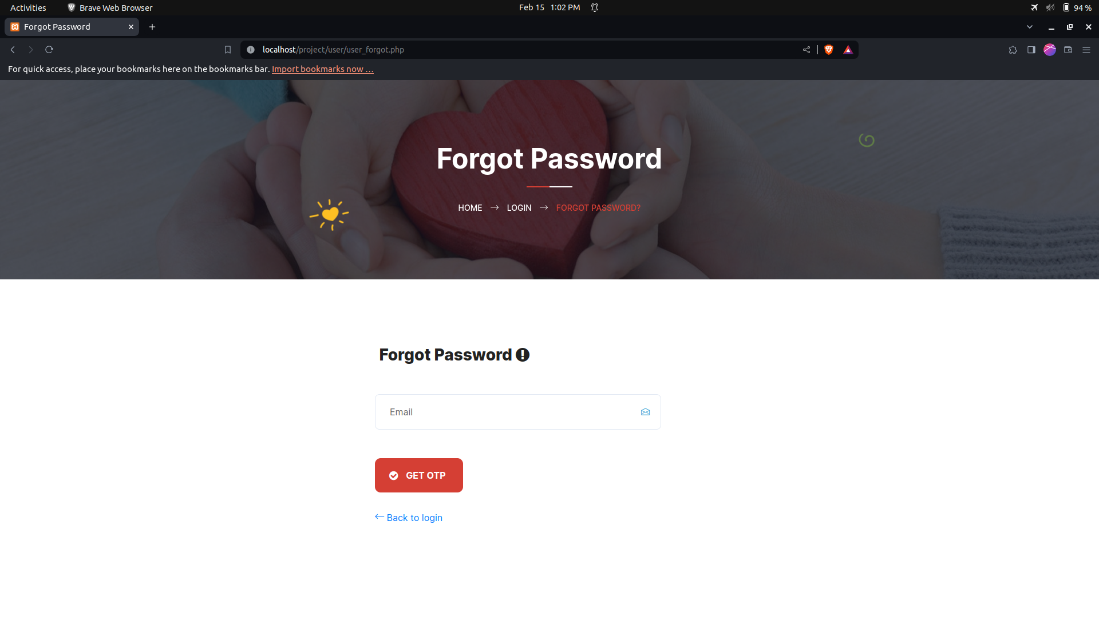
User Forgot Password:

Slide 50

User Not Found:

Slide 51
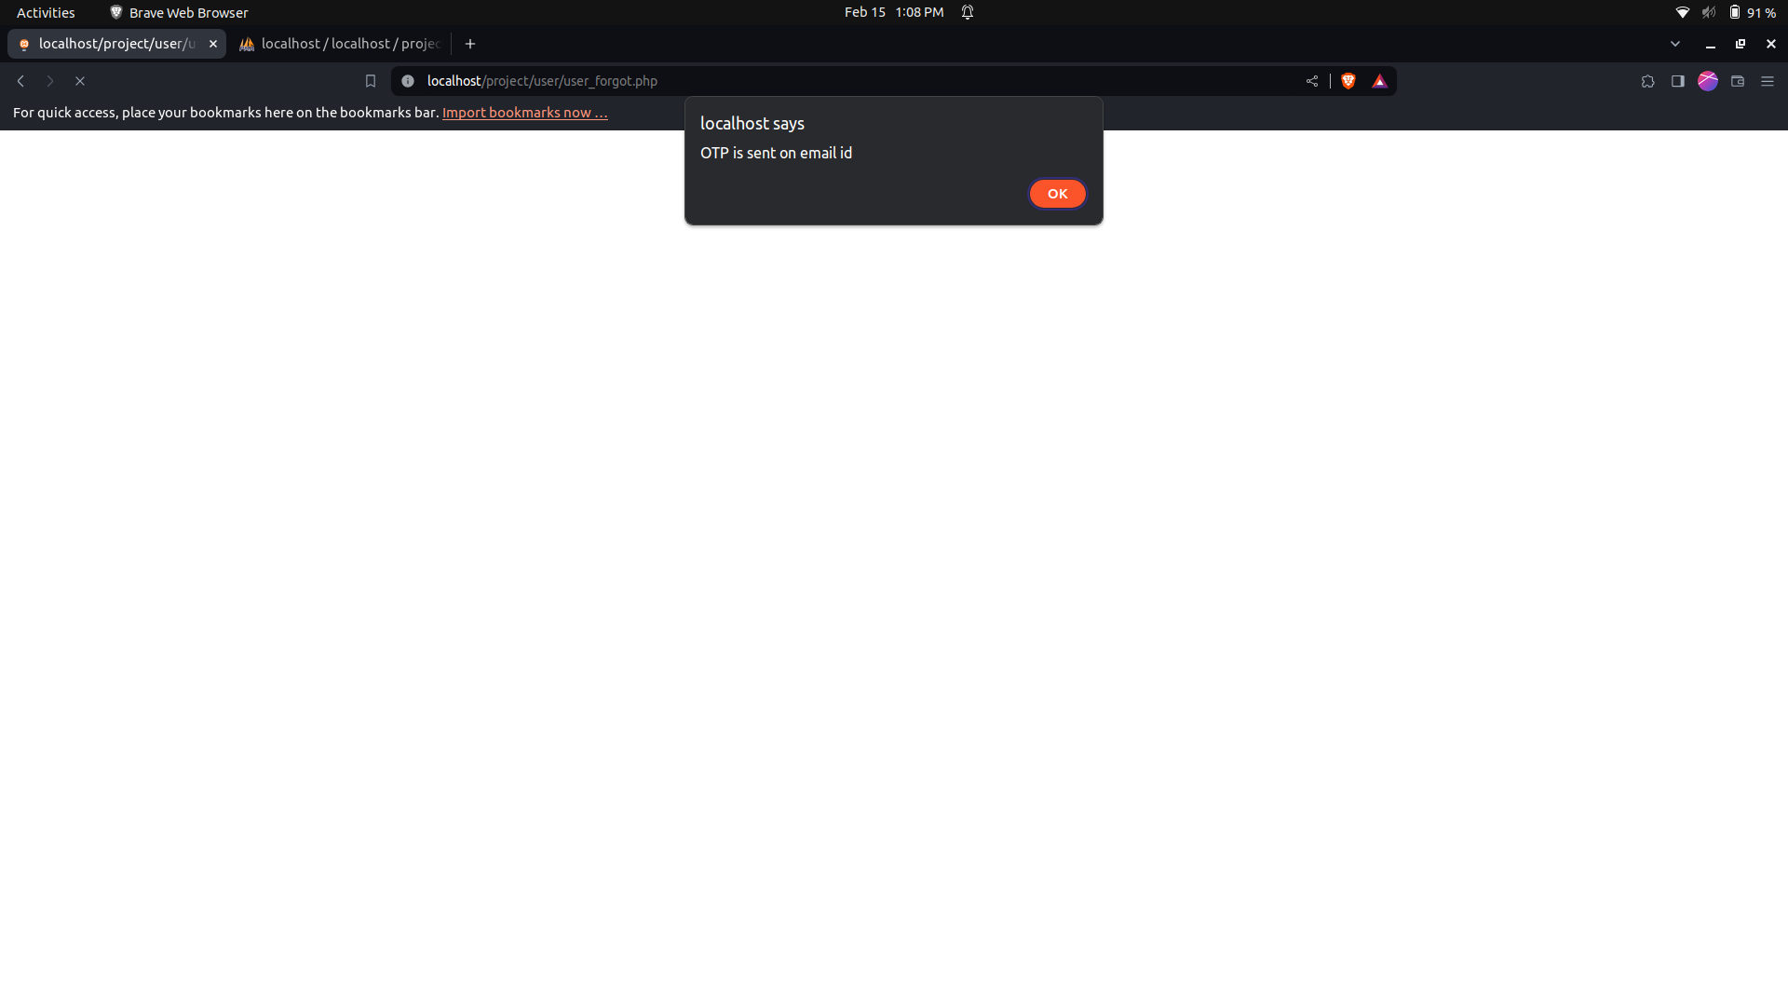
OTP sent to email:

Slide 52
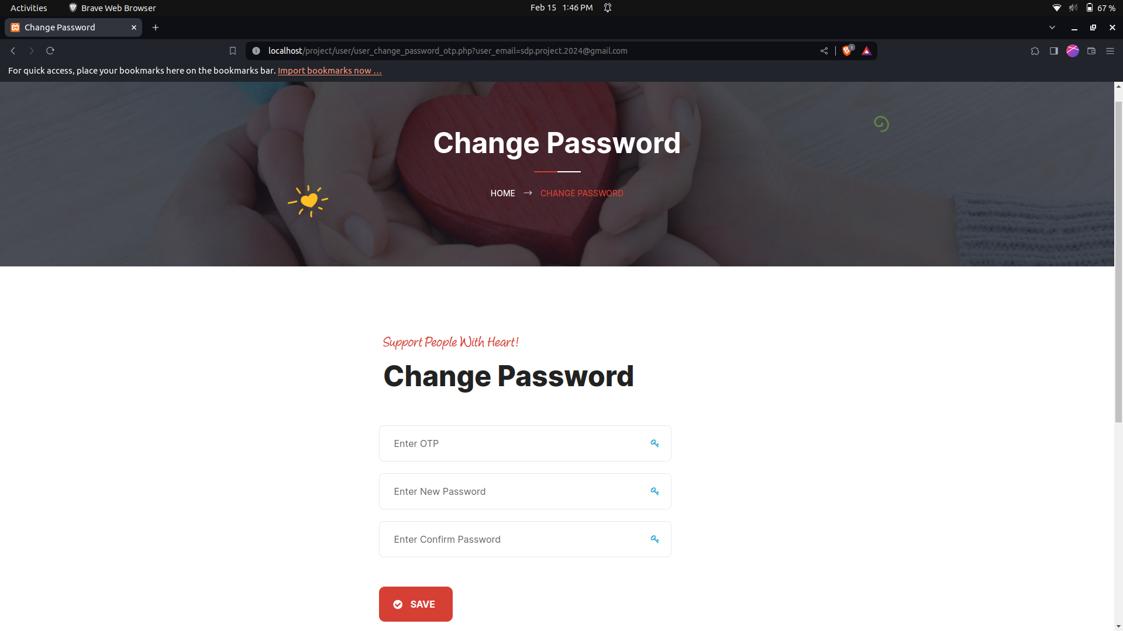
User Change Password:

Slide 53

Incorrect OTP:

Slide 54

OTP and New Password:

Slide 55

New and Confirm Password:

Slide 56


Slide 57
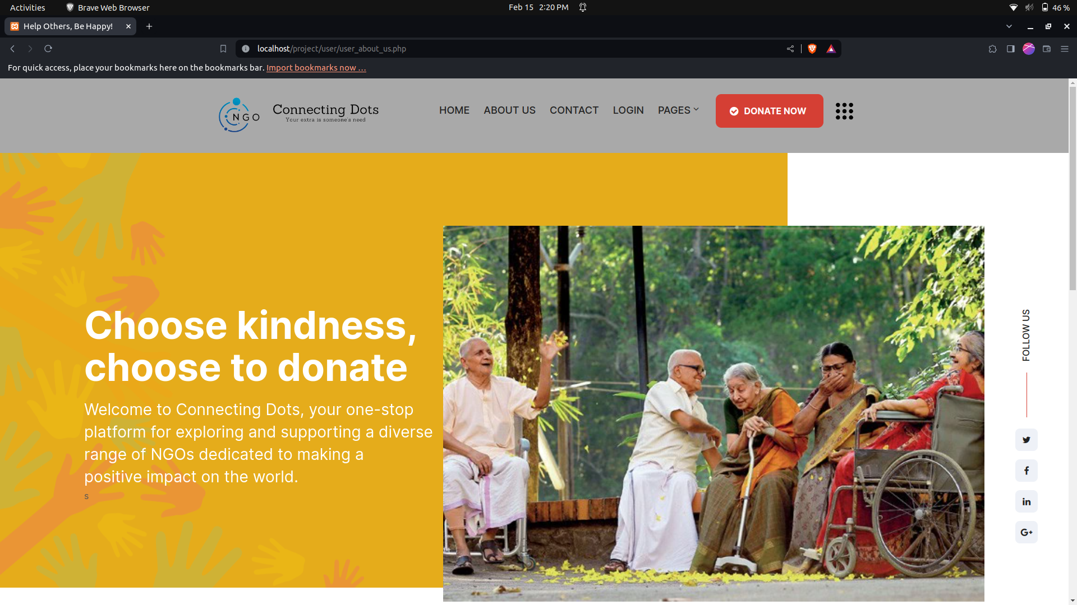
About Us:

Slide 58
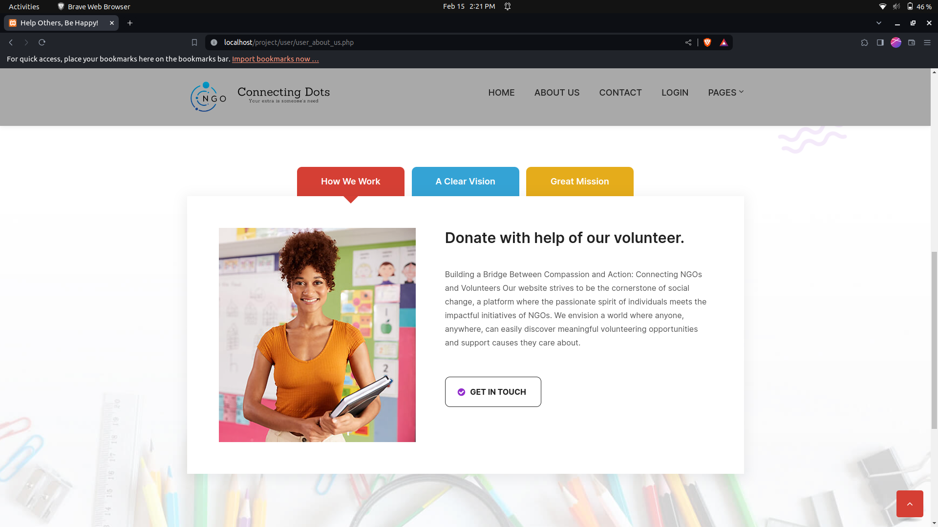
About Us:

Slide 59
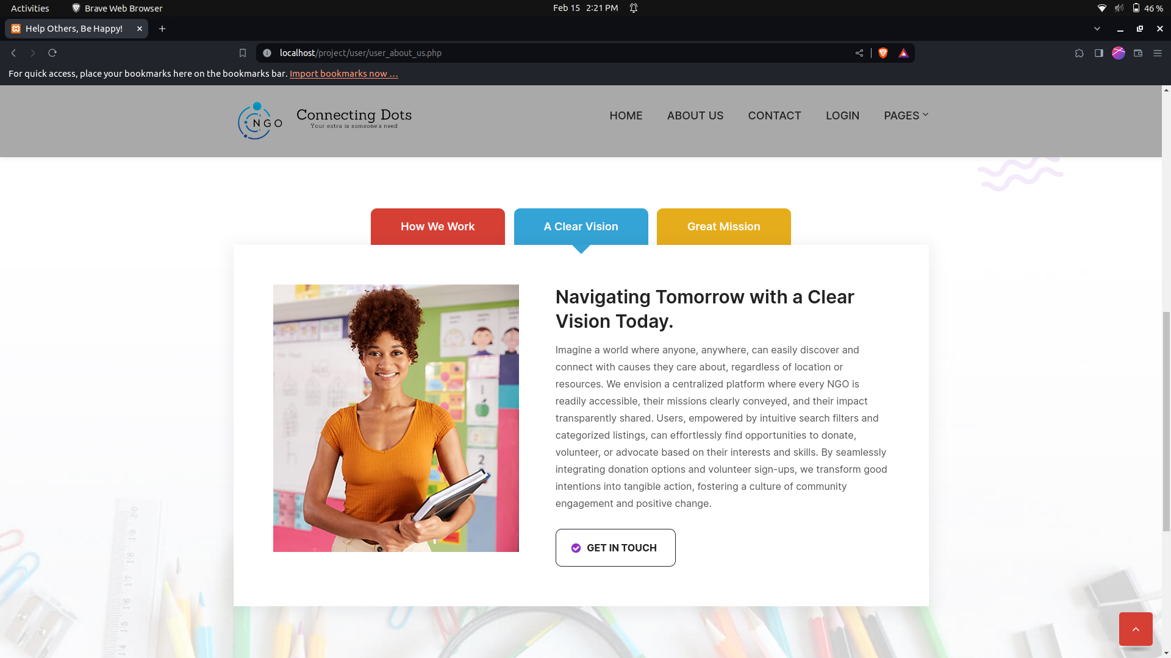
About Us:

Slide 60

About Us:

Slide 61
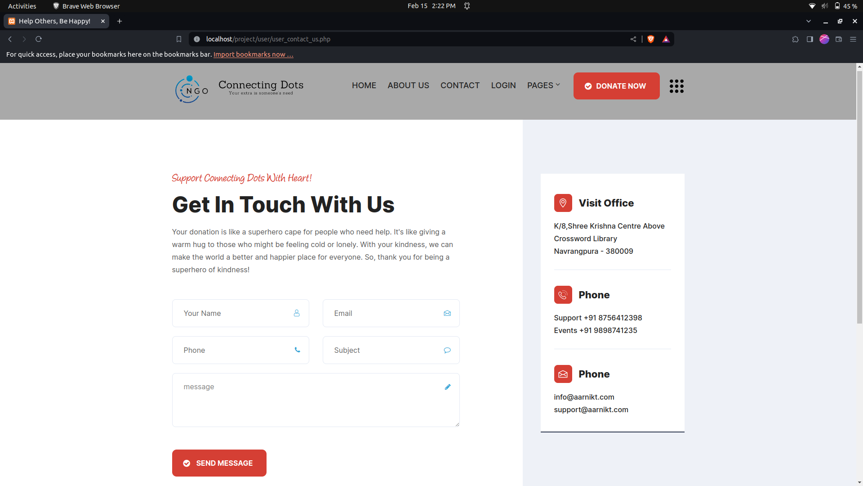
Contact Us:

Slide 62
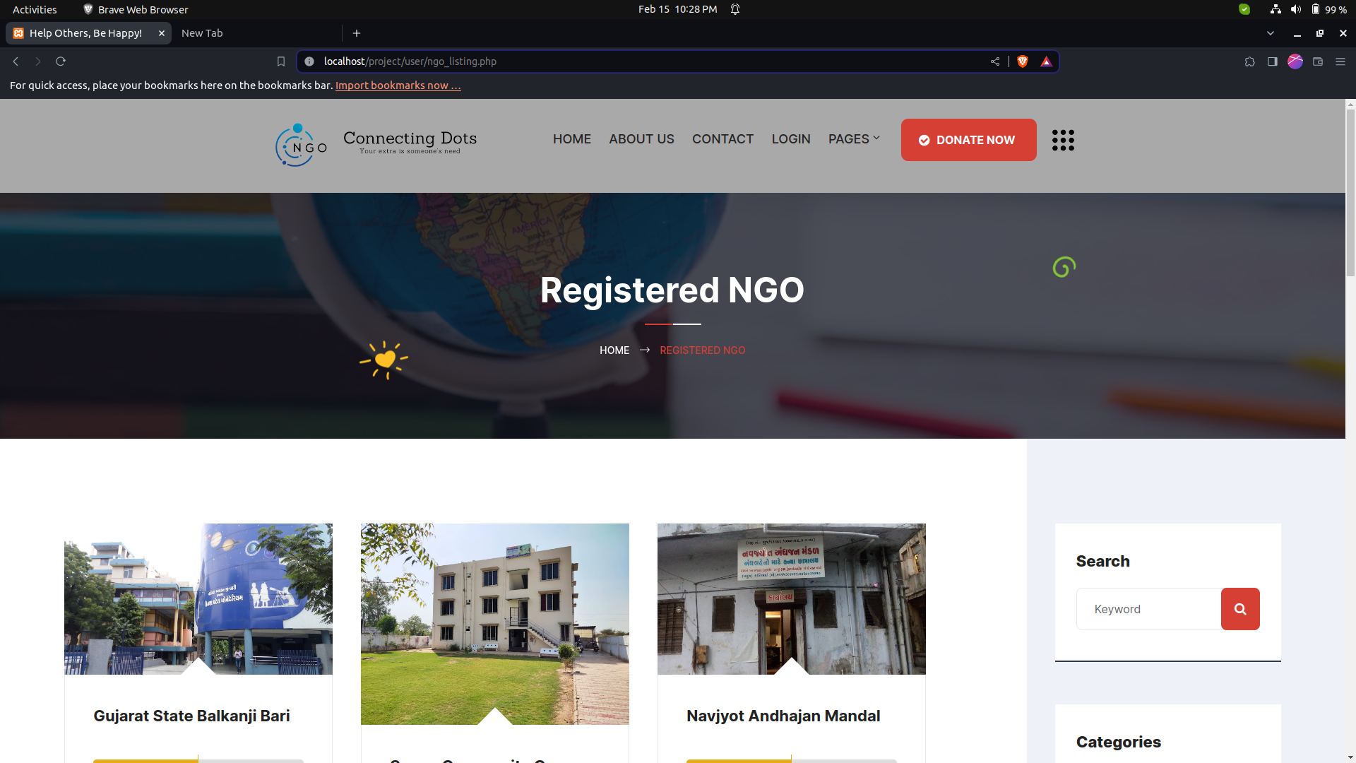
NGO List:

Slide 63
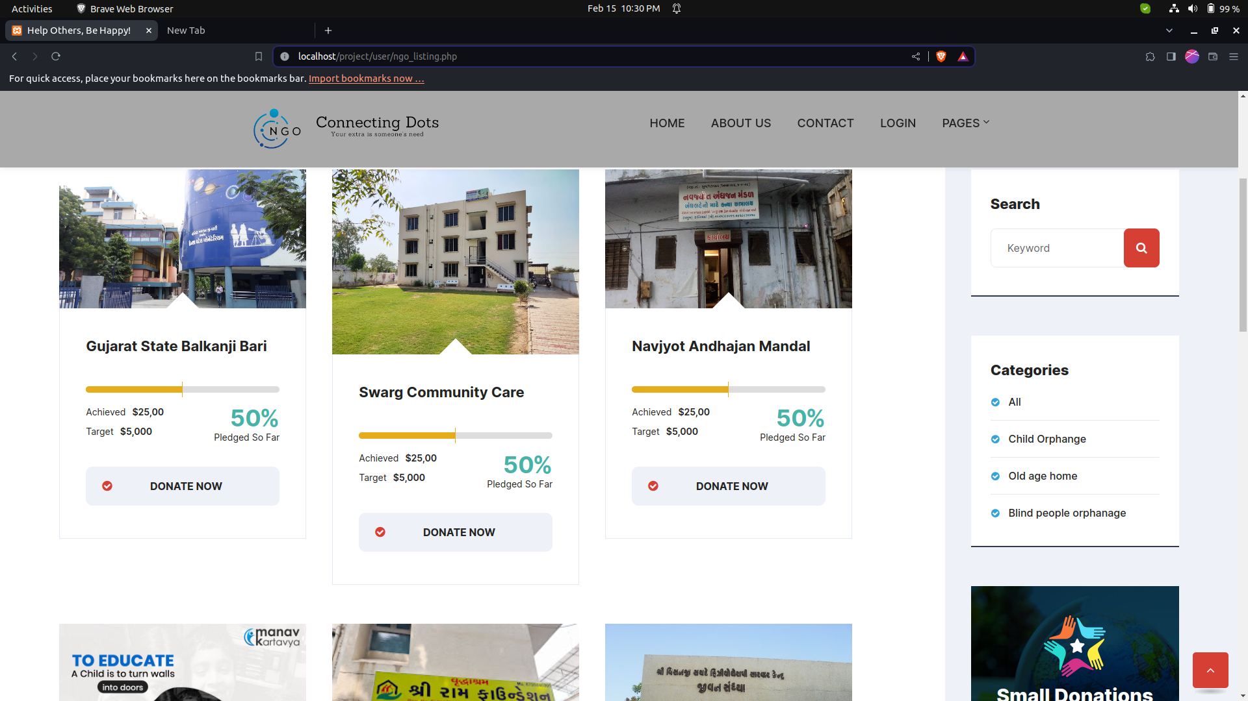
NGO List:

Slide 64
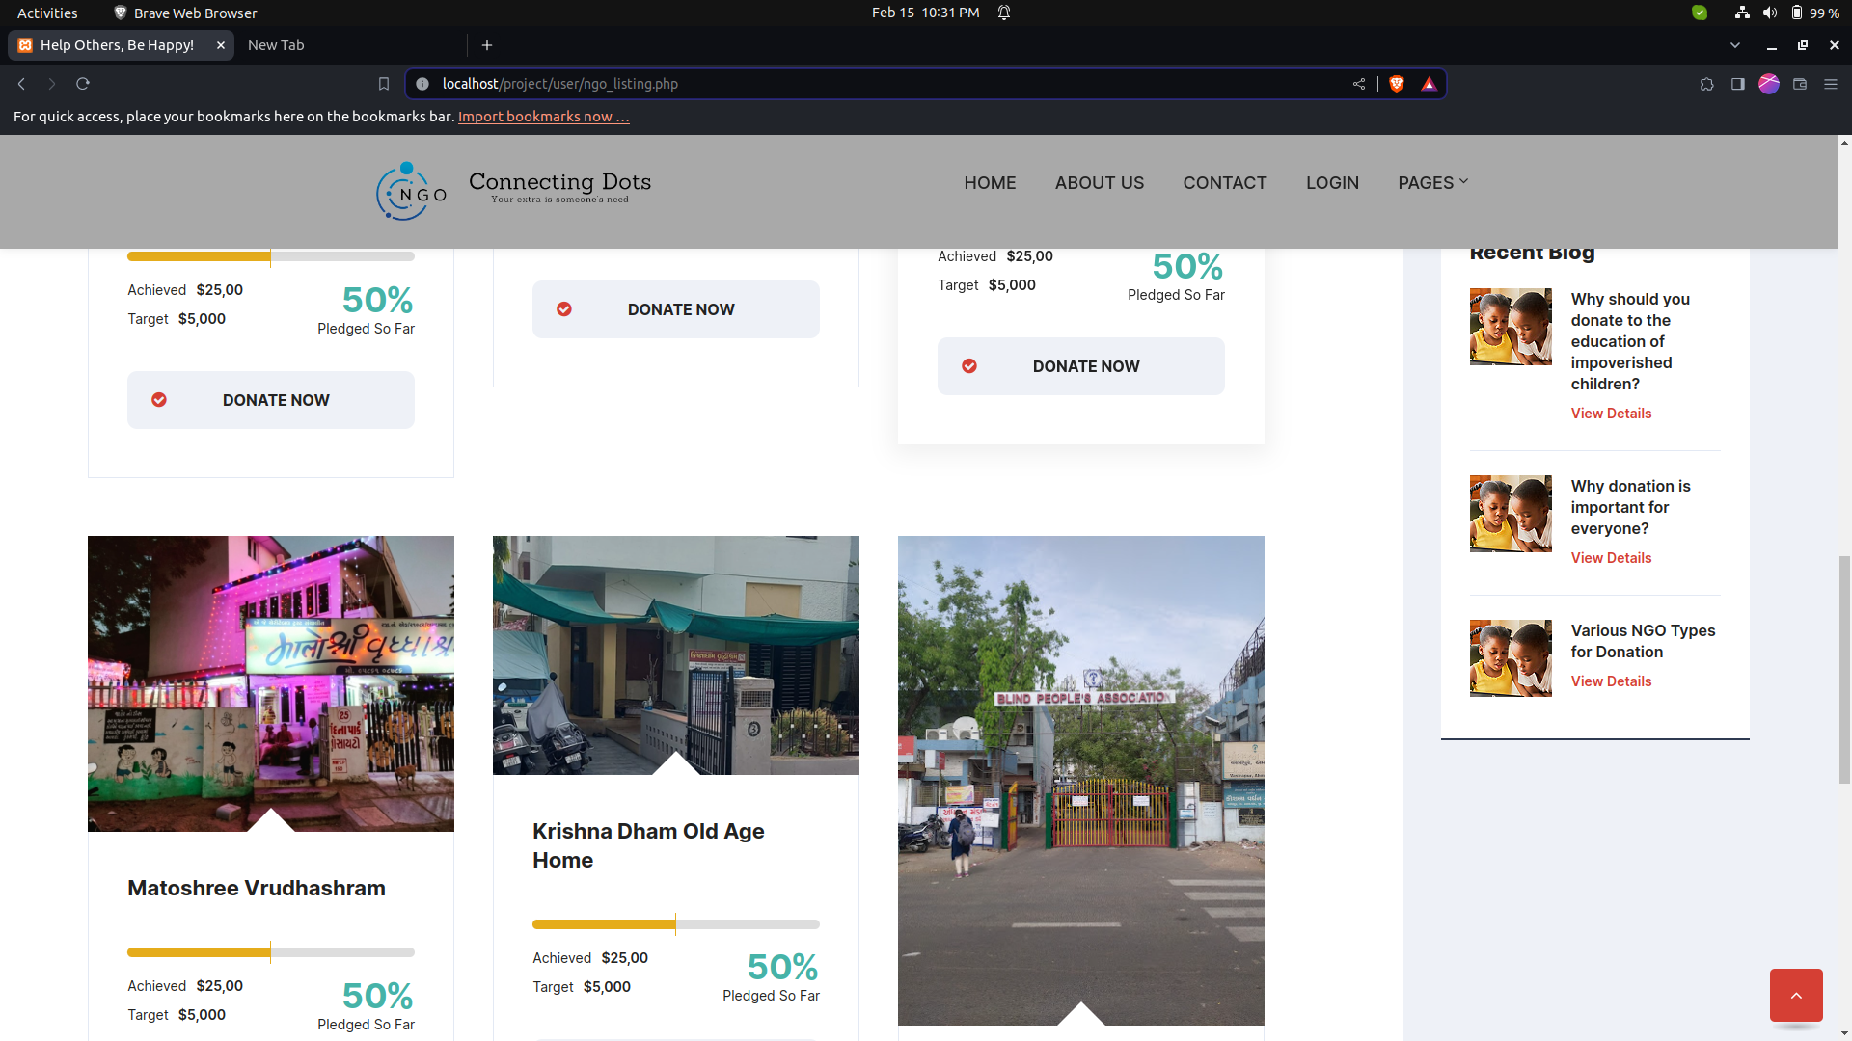
NGO List:

Slide 65
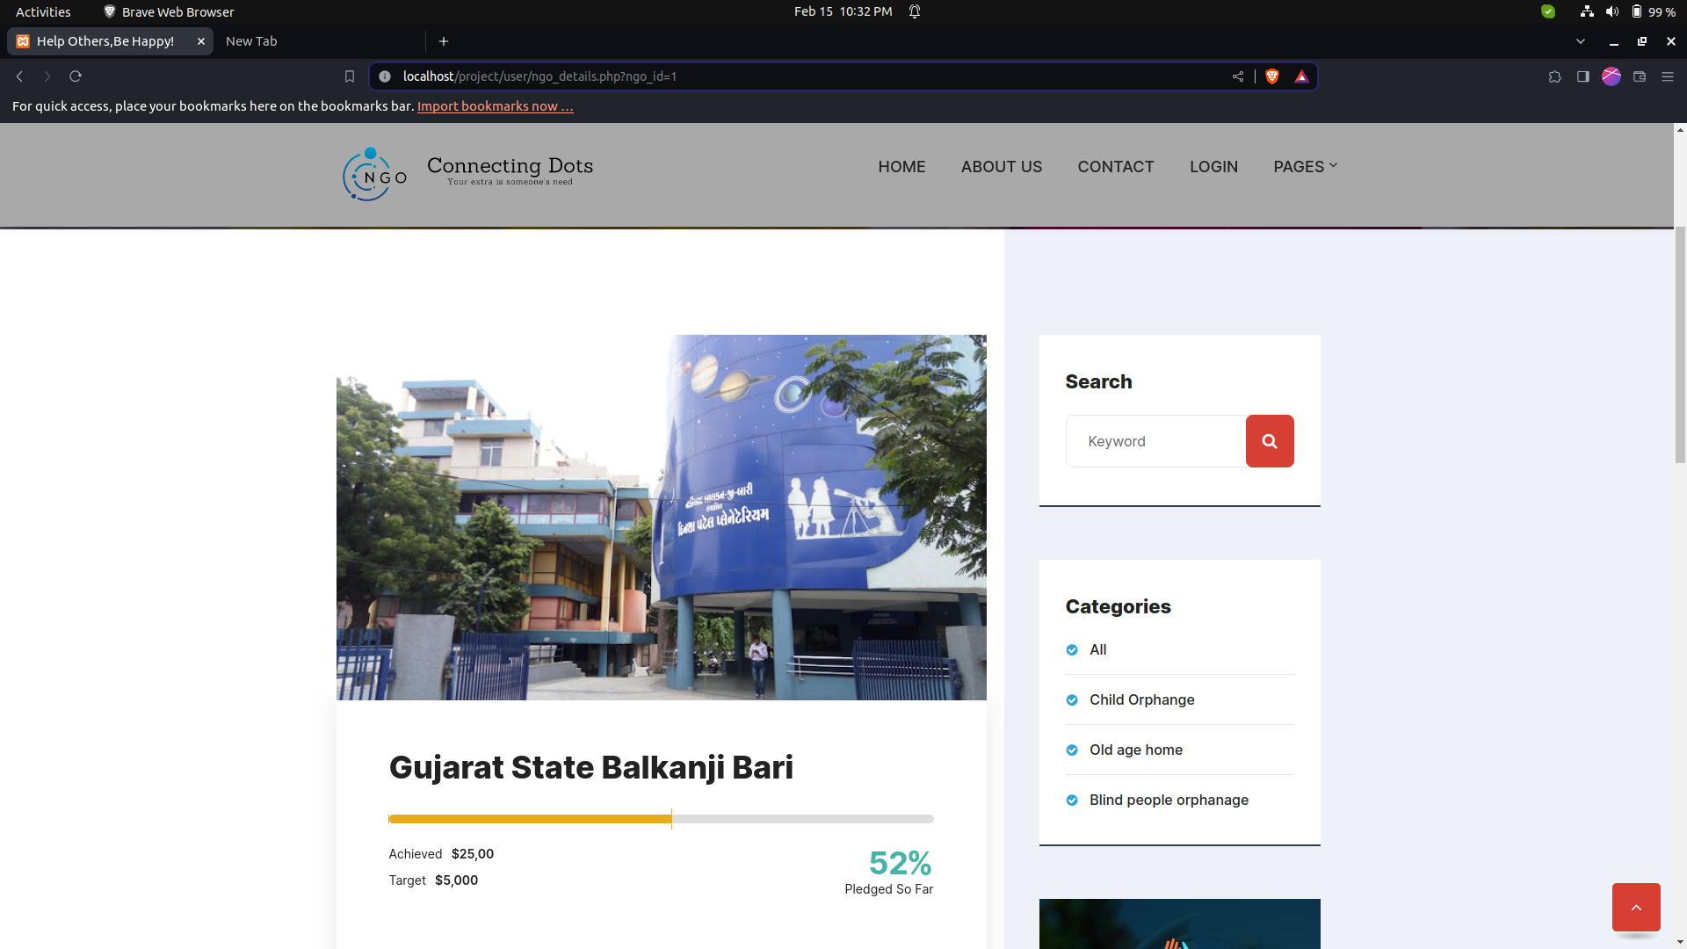
NGO Details:

Slide 66
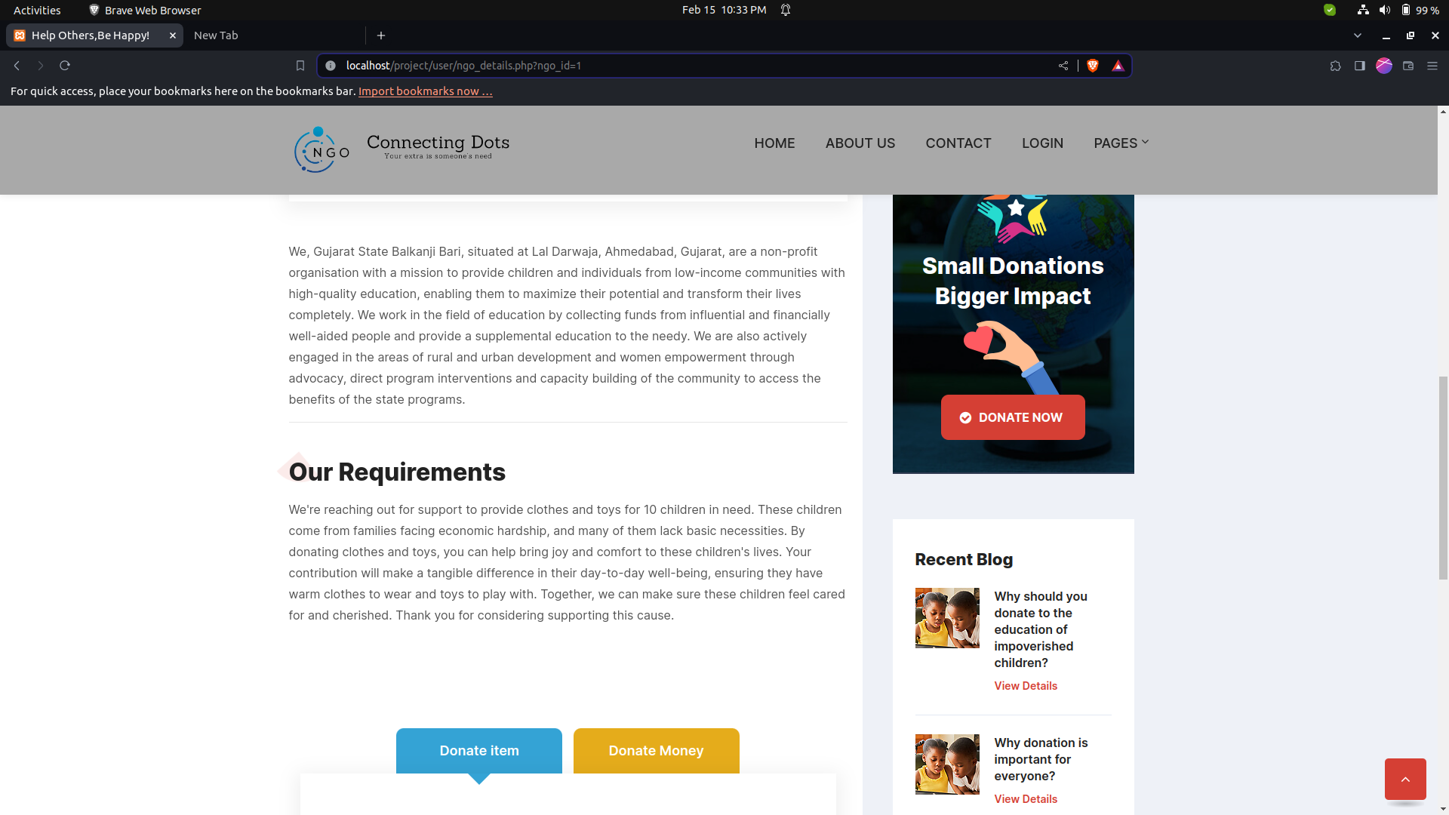
NGO Details:

Slide 67
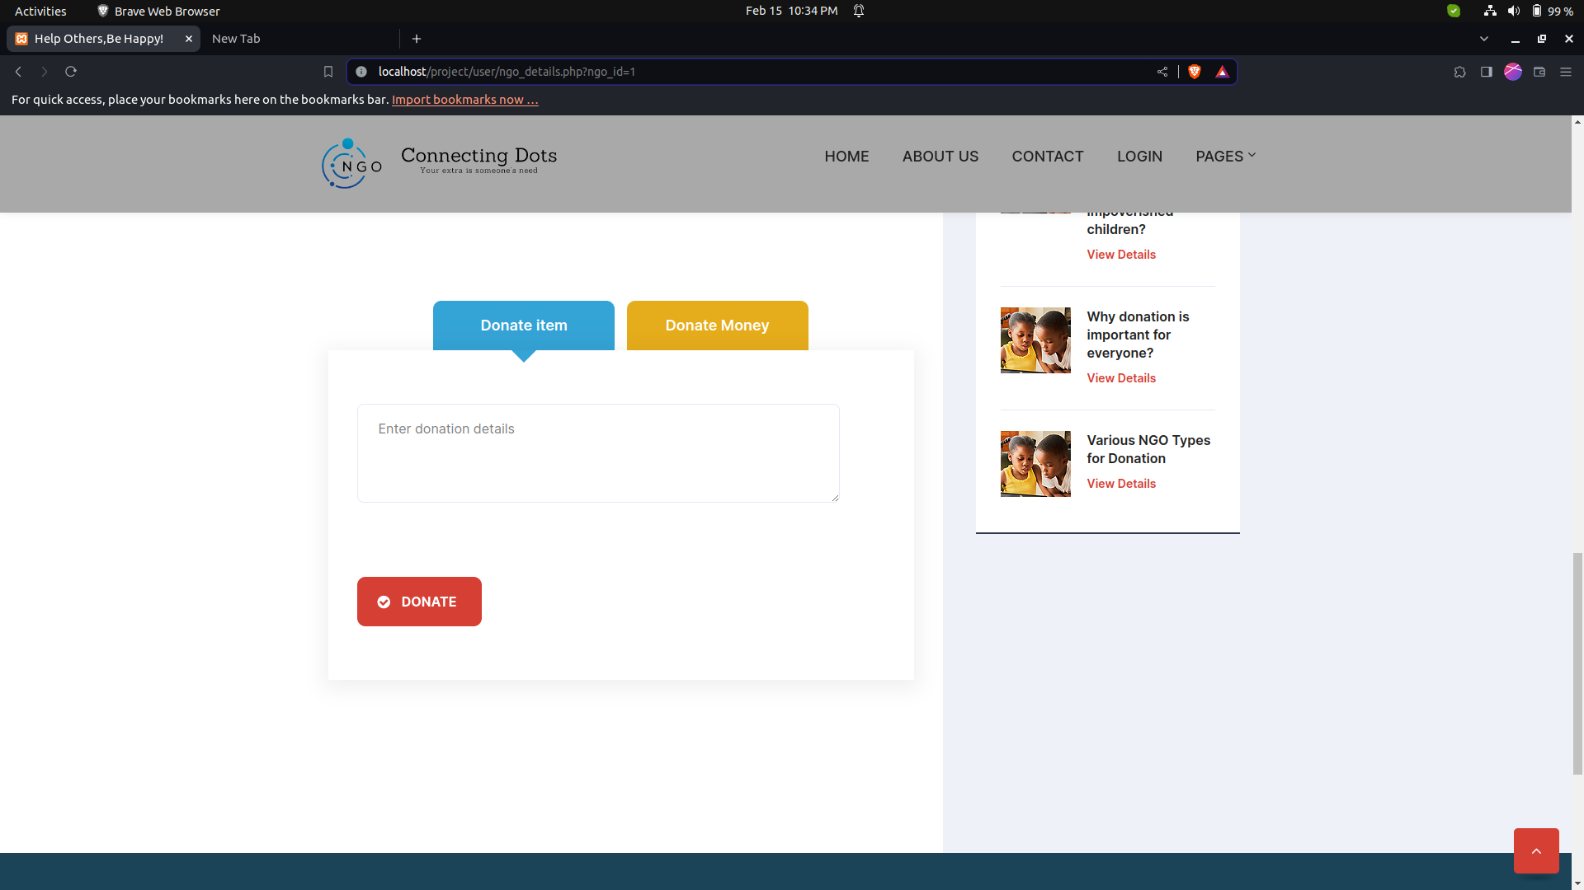
NGO Details:

Slide 68
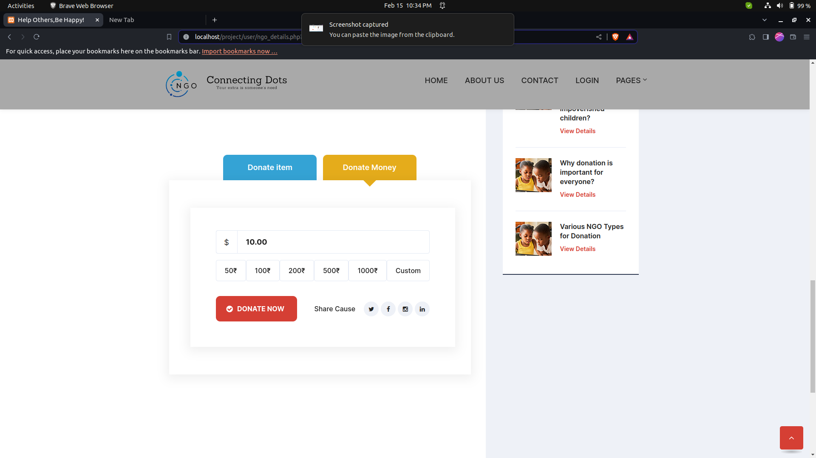
NGO Details:

Slide 69
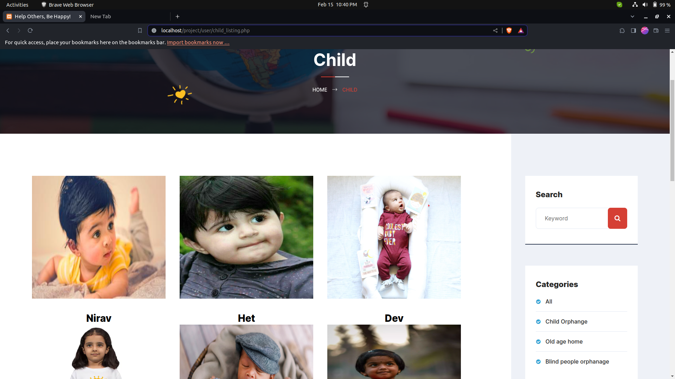
Child List:

Slide 70
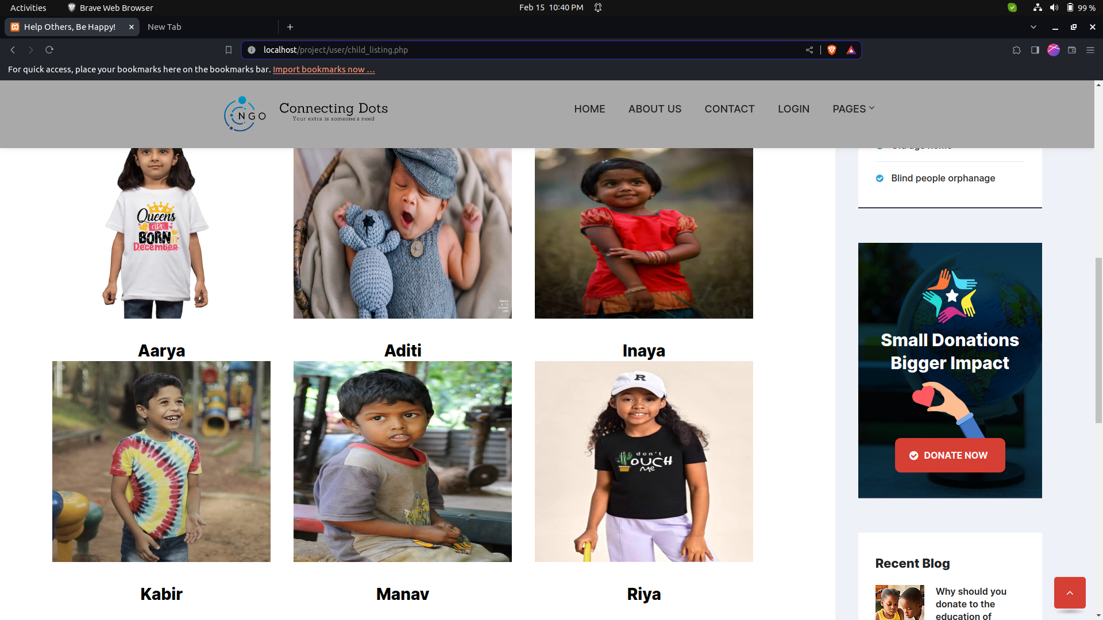
Child List:

Slide 71
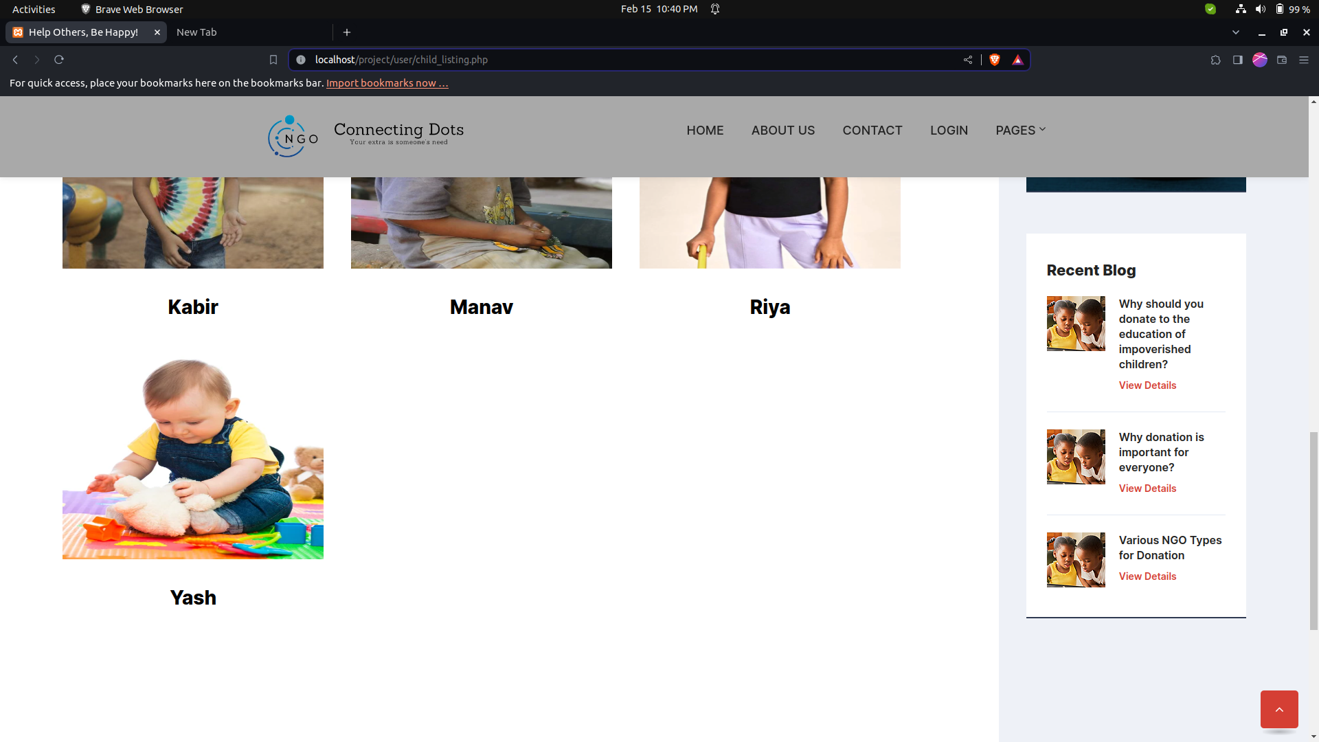
Child List:

Slide 72
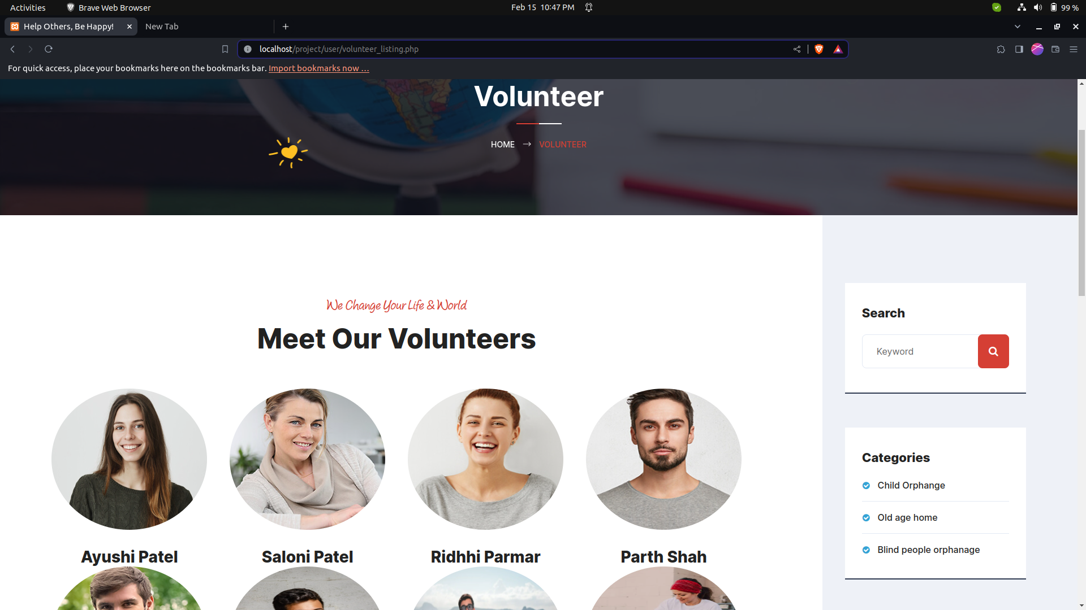
Volunteer List:

Slide 73
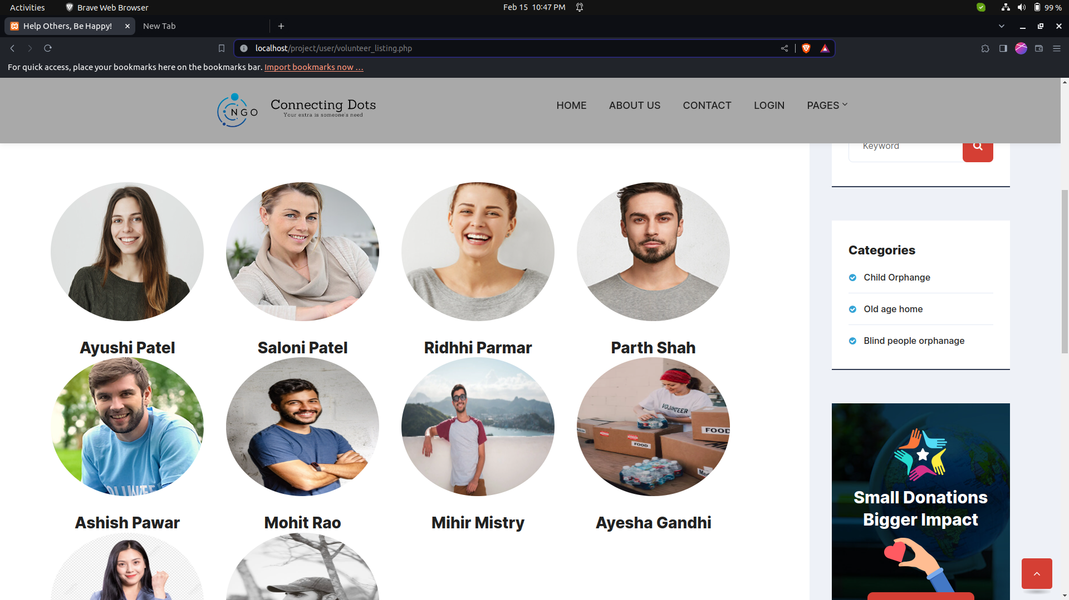
Volunteer List:

Slide 74

Blog List:

Slide 75

Blog Details:

Slide 76

Blog Details:

Slide 77

FAQ:

Slide 78
07
Conclusion

Slide 79

Conclusion
Thus we conclude that we enjoyed very much working on the project “Connecting Dots” our internal guide Prof. Deep helped us a lot in improving the quality of our project.
This is just the Stepping stone for project development there is new paths to be discovered and there are new goals that are to be achieved .

Slide 80
08
Bibliography

Slide 81
Reference Book :-
1. Magnifying Object-Oriented Analysis and Design
Authors : Arpita Gopal and Netra Patil
Publisher : PHI Learning
Internet :-
https://www.google.com/
https://www.w3schools.com/

Slide 82



Thanks

